Slide 1




GEROSCIENCE EDUCATION & TRAINING
Energy and Metabolism:
Metabolic Flux and Protein Metabolism
Brought to you by

Slide 2
GEROSCIENCE EDUCATION & TRAINING
The Geroscience Education and Training Network and the GET 2 Network Collaborative (GET Network + GSA) are supported by the National Institute on Aging of the National Institutes of Health under Awards Number R25AG073119 (NIA GCG) and R25AG091038 (NIA DAB).
The content is solely the responsibility of the authors and does not necessarily represent the official views of the National Institutes of Health.
Brought to you by

Slide 3
Metabolic flux and protein metabolism
The limits of snapshots when trying to understand a moving picture.

Slide 4
Learning Objectives
To understand the concept of metabolic flux.
To understand the limitations of snapshots compared to moving pictures.
Describe one approach for measuring flux.
To understand important factors in the flux (turnover) of protein.
Understand how to target protein turnover to slow aging.

Slide 5
To understand the concept of metabolic flux
Objective 1

Slide 6
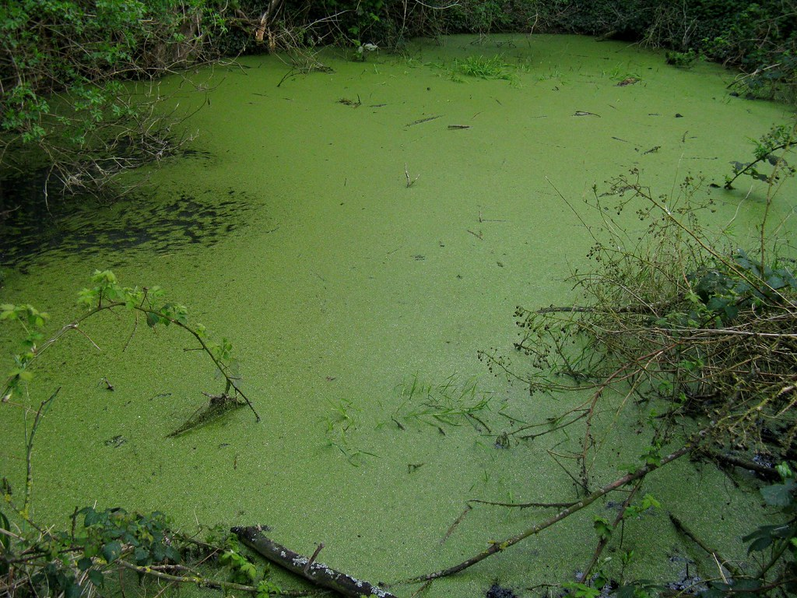

Flux - Continuous change, passage, or movement

Slide 7
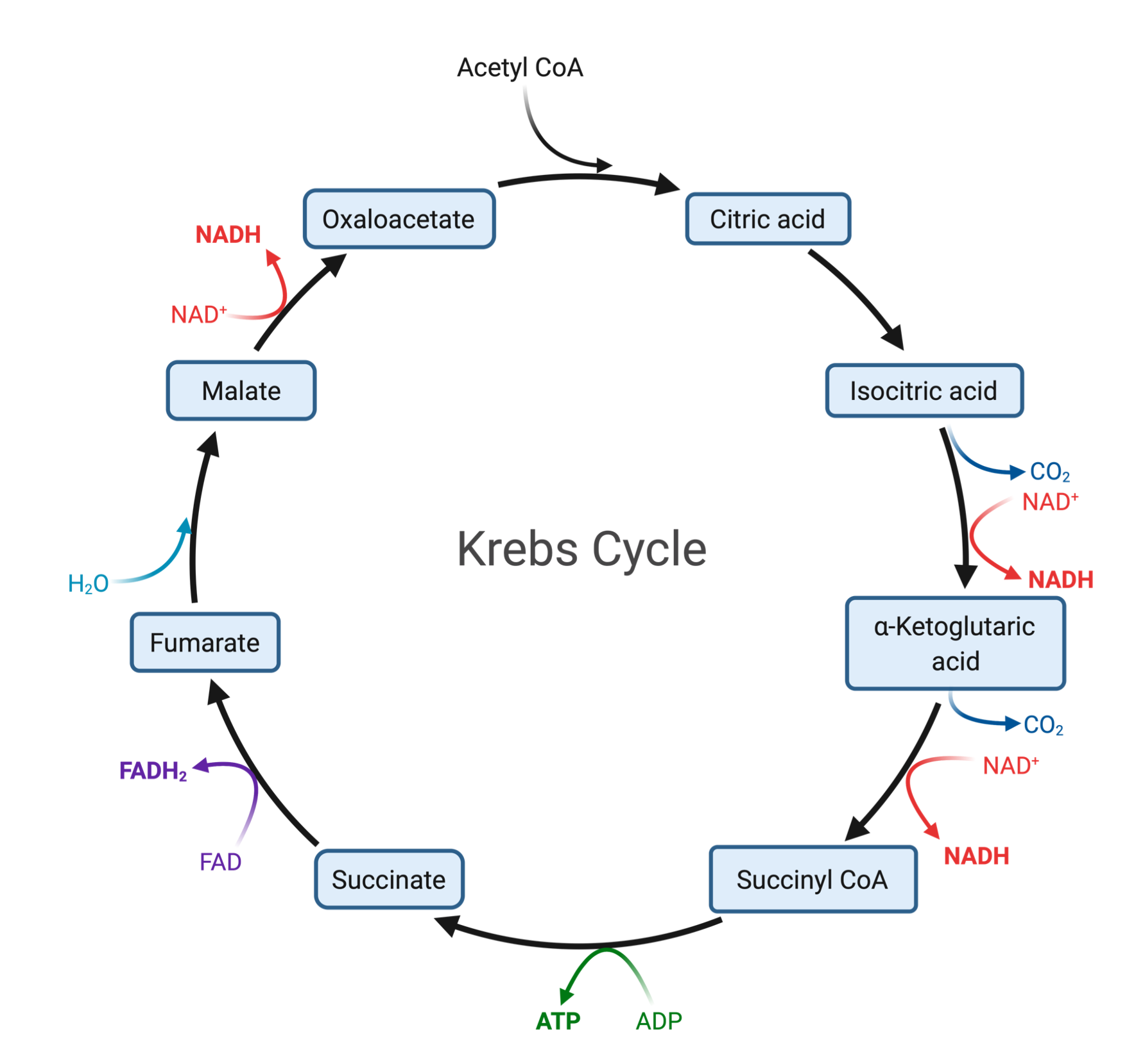
Metabolic flux- The rate of turnover of molecules through a metabolic pathway.

Slide 8
To understand the limitations of snapshots compared to moving pictures.
Objective 2

Slide 9
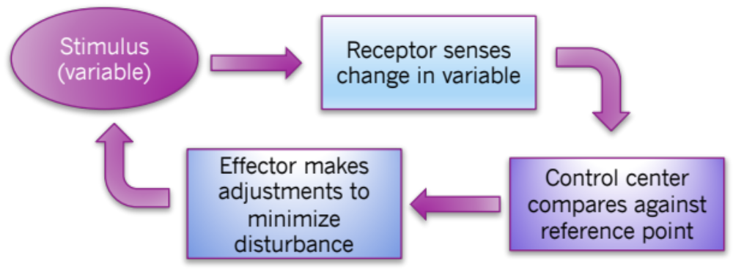
Adaptation is dynamic

Slide 10
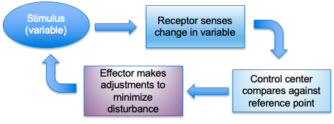
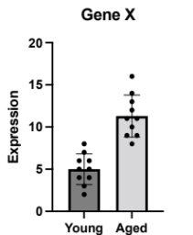

Snapshot

Slide 11
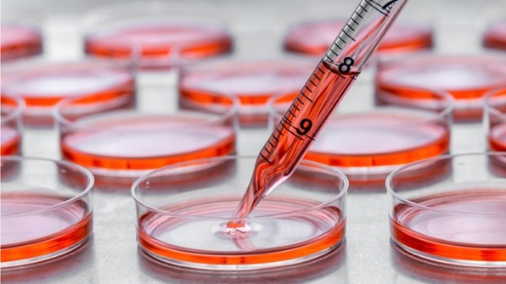
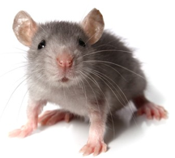
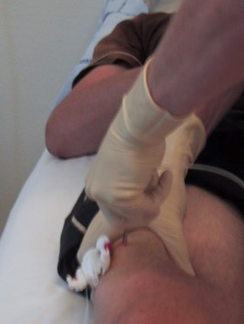
6 months later

Slide 12
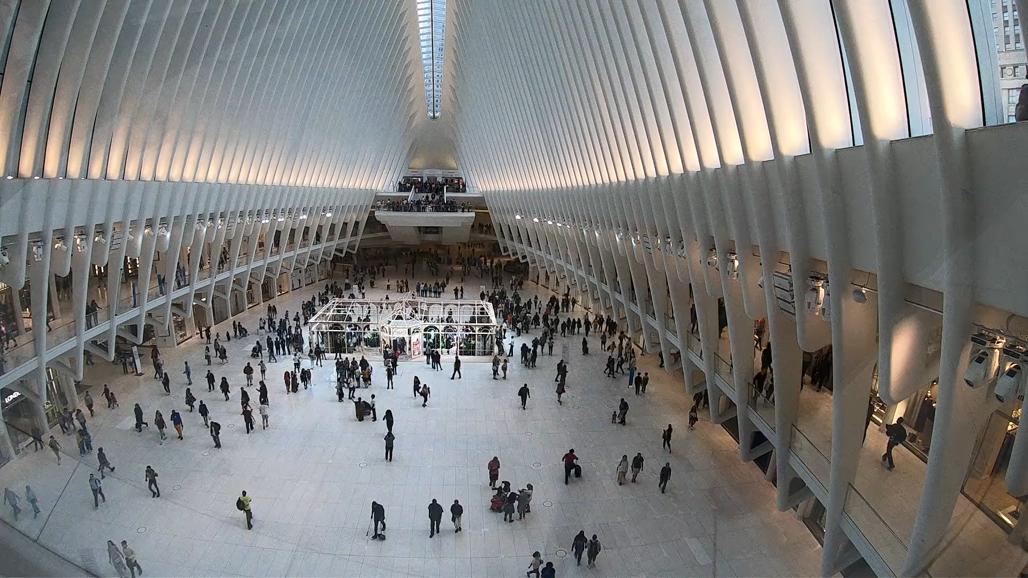

Slide 13
Describe one approach for measuring metabolic flux.
Objective 3

Slide 14
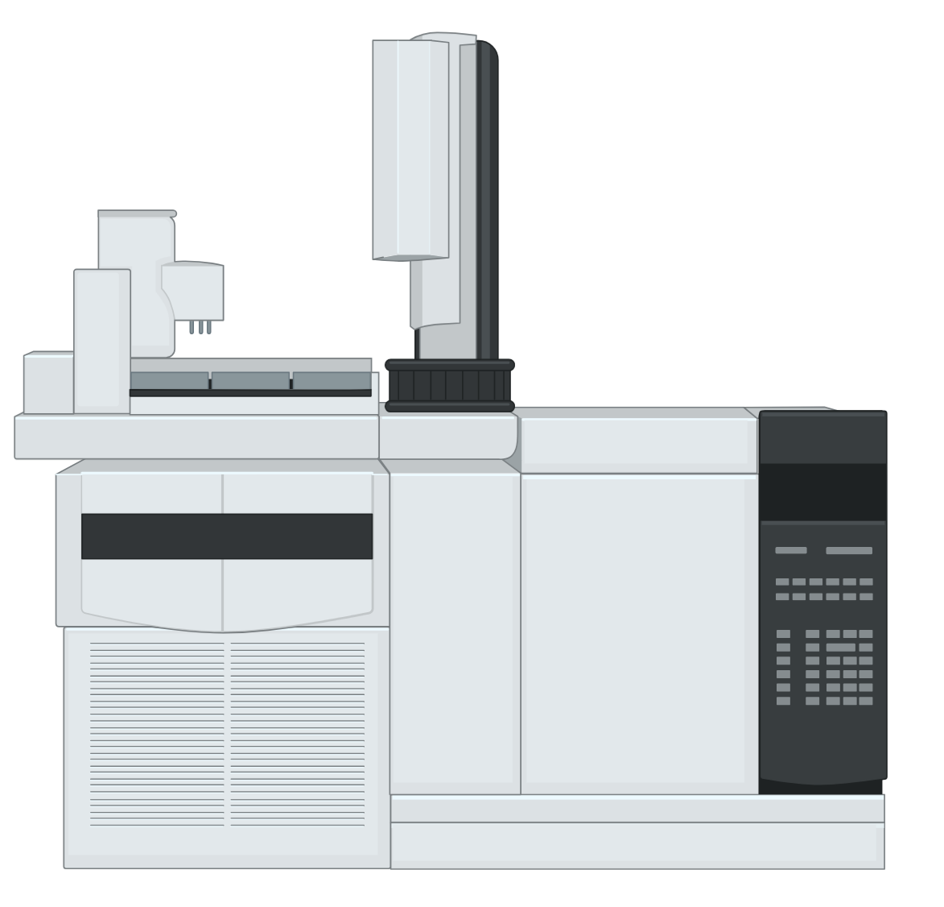
How do we measure metabolic flux?
Protons: 6
Neutrons: 6
Atomic mass: 12
Protons: 6
Neutrons: 7
Atomic mass: 13
Molecules with stable isotopes are
indistinguishable in physiological processes.

Slide 15
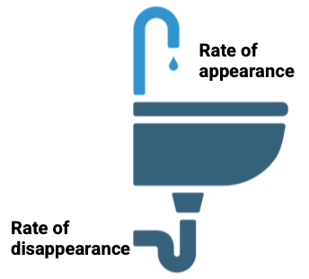
Tracer-measured metabolic flux
Liver
Blood glucose
Glycogen
Oxidized
Metabolically active tissues

Slide 16
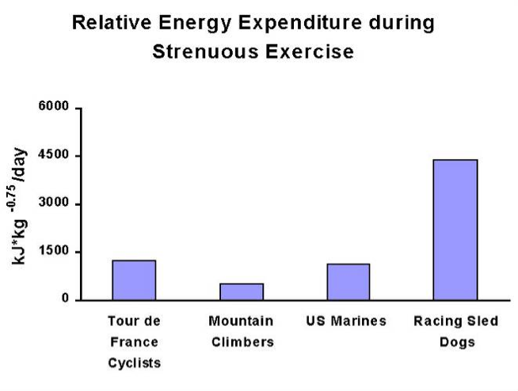
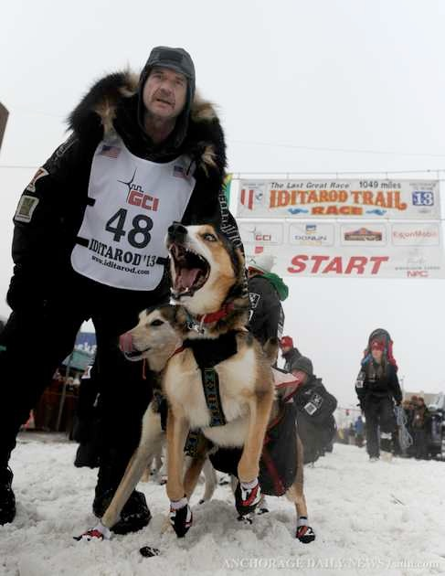
Example: Substrate use for energy metabolism

Slide 17
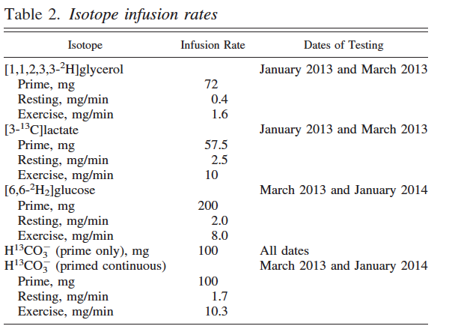

Slide 18
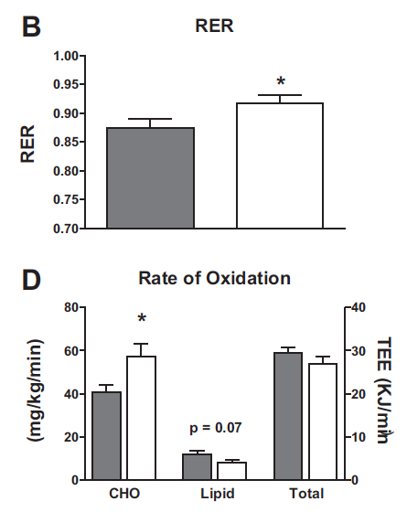

Notes:
Worried about bicarb because of contracting spleen.
RER is high and INCREASES post Iditarod
Relative rates of oxidation are CHO dominant and increases post-Iditarod

Slide 19
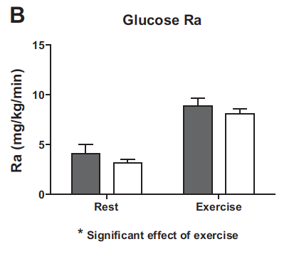
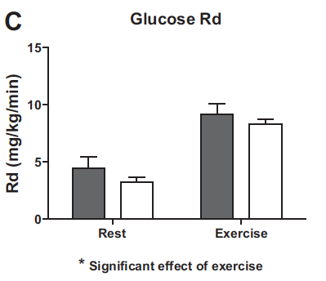
Notes:
Bars are human values at 45% VO2max

Slide 20
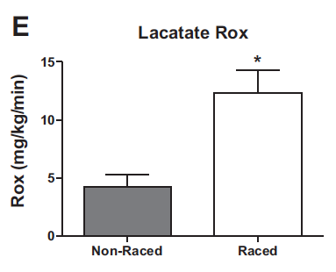
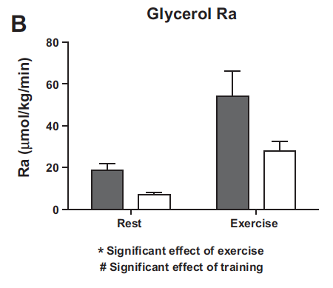
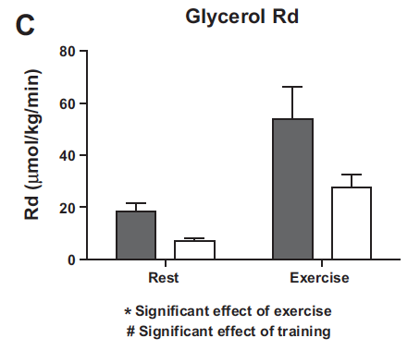
Notes:
Glycerol concentration very high - high rate of lipolysis and very high rate of Rd to liver.

Slide 21
What was learned by measuring flux
Contrary to what was assumed in the literature, Iditarod sled dogs are reliant on glucose during exercise.
However, the glucose is made possible by a high rate of gluconeogenesis from the glycerol that comes from adipose tissue.

Slide 22
To understand important factors in the flux (turnover) of protein
Objective 3

Slide 23
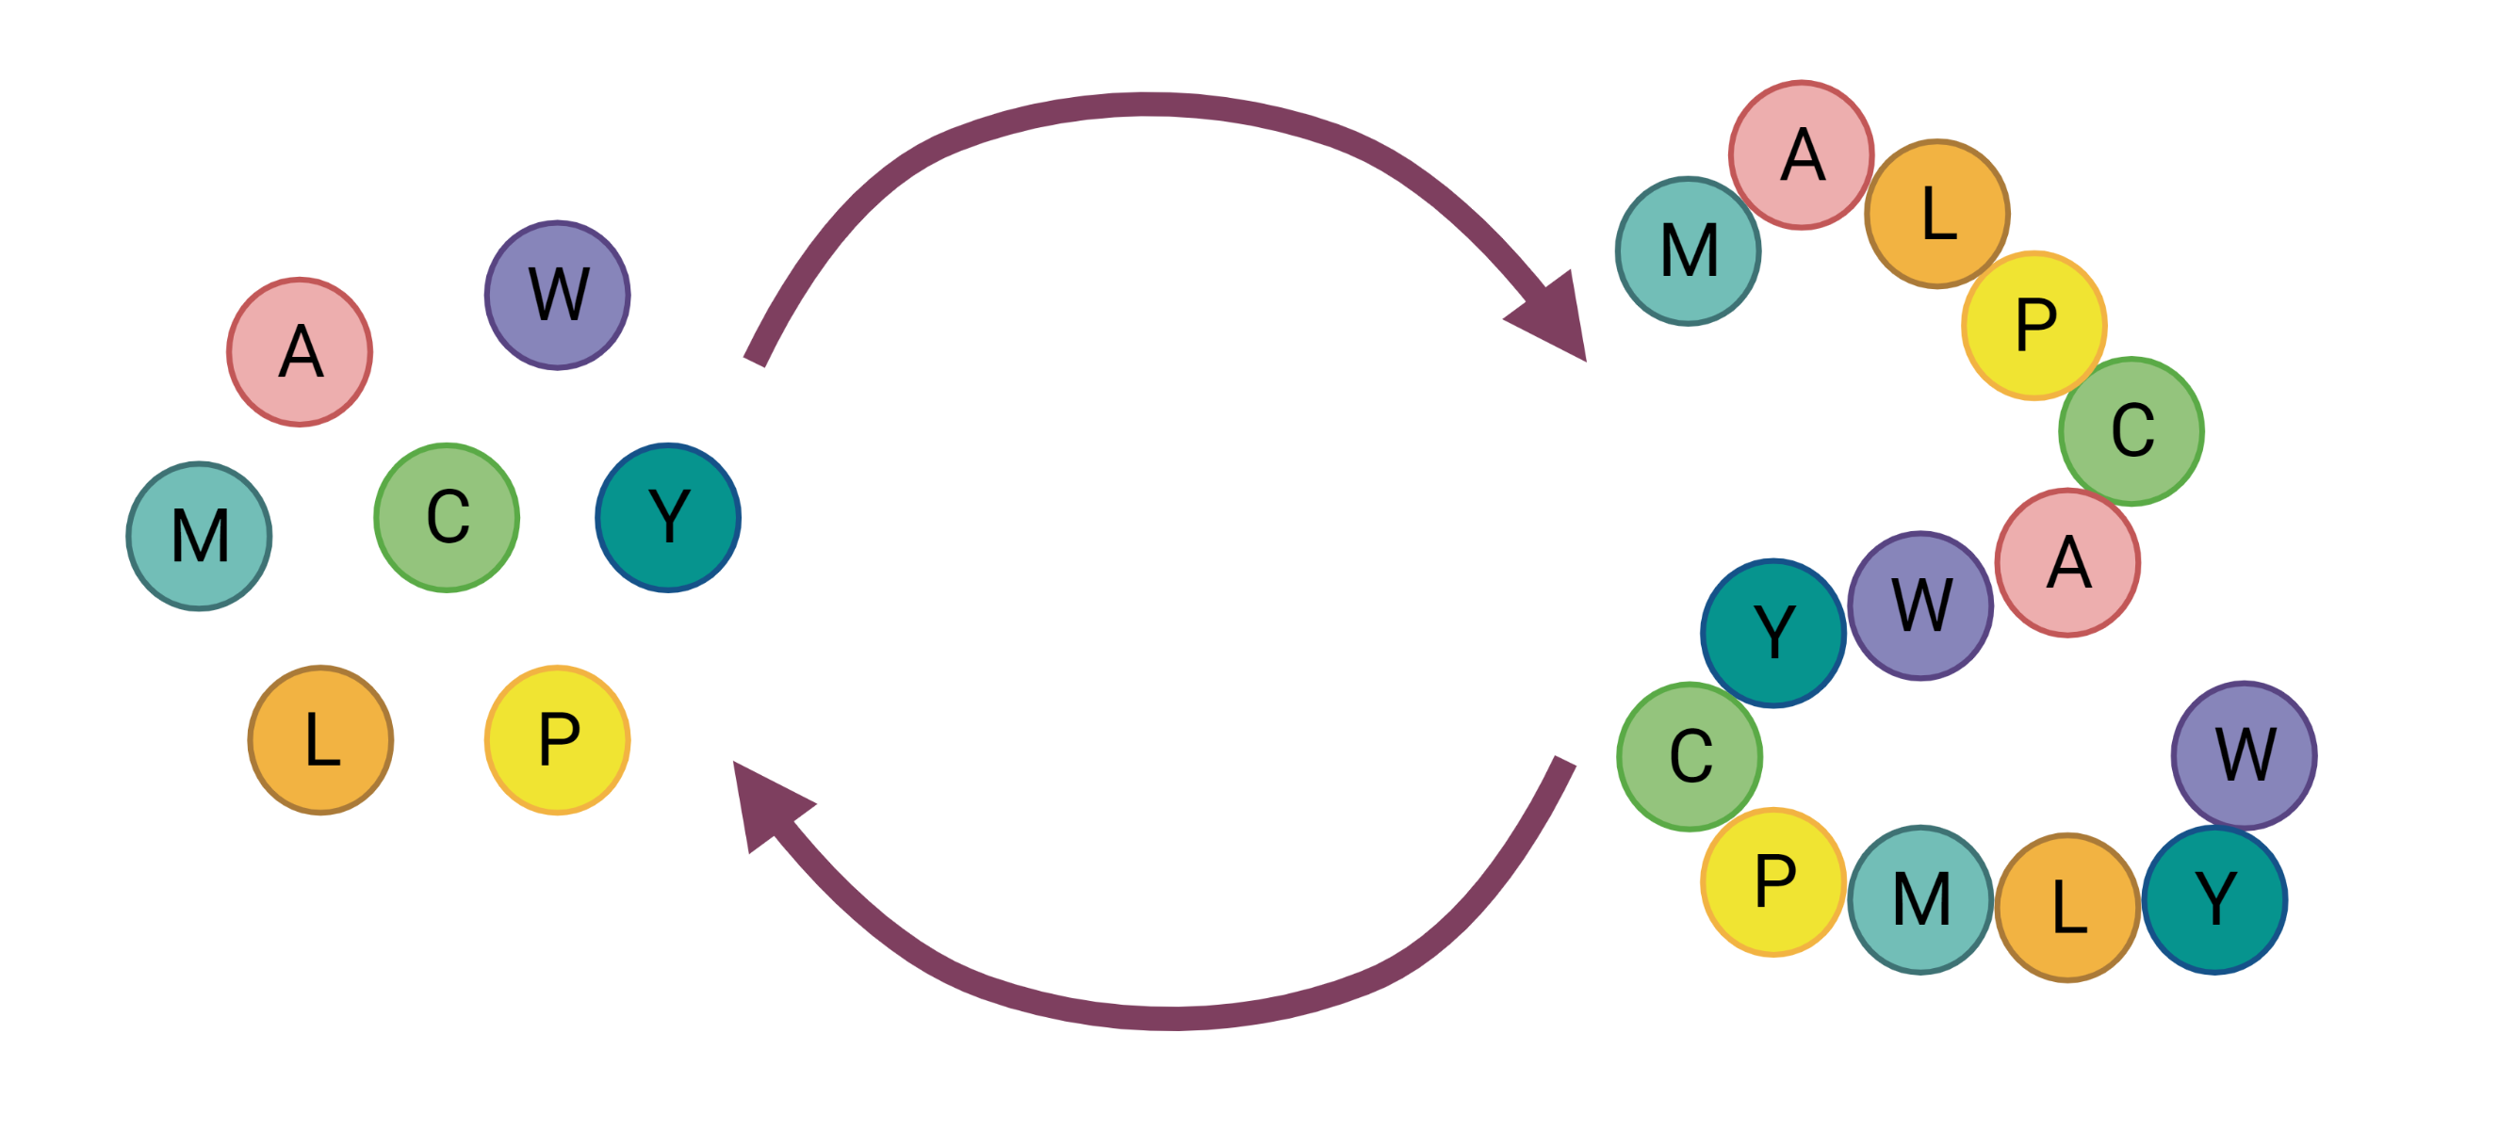
Turnover (a form of metabolic flux)
SYNTHESIS
BREAKDOWN

Slide 24
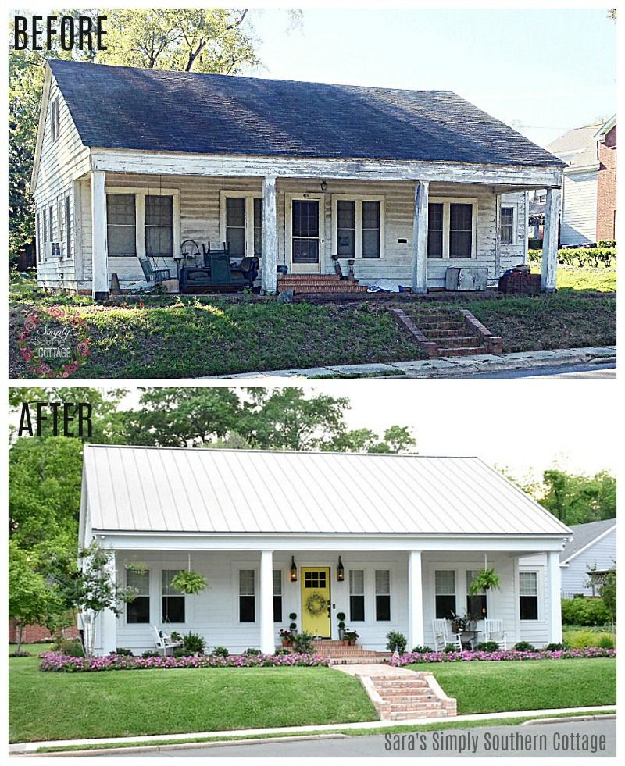
Initial paradigm of protein turnover with aging

Slide 25
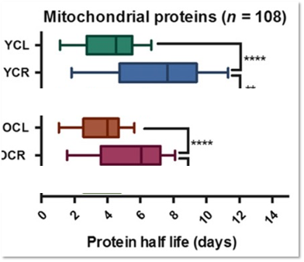
Impact of gerotherapeutics on protein turnover
Aging slows protein turnover resulting in the accumulation of damaged proteins.
Treatments that slow aging (like rapamycin and CR) slow protein synthesis.
Treatments that slow aging increase protein breakdown (e.g. autophagy).

Slide 26
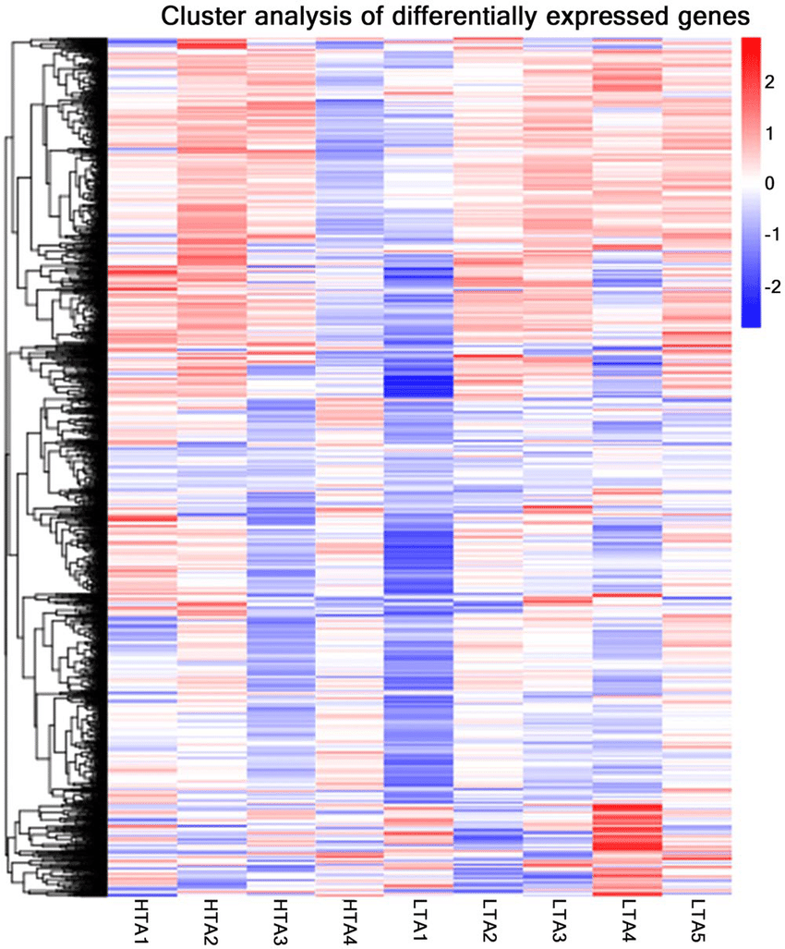

“Protein synthesis” is not a thing
Muscle Protein Synthesis (FSR) = 2.8%/hr

Slide 27
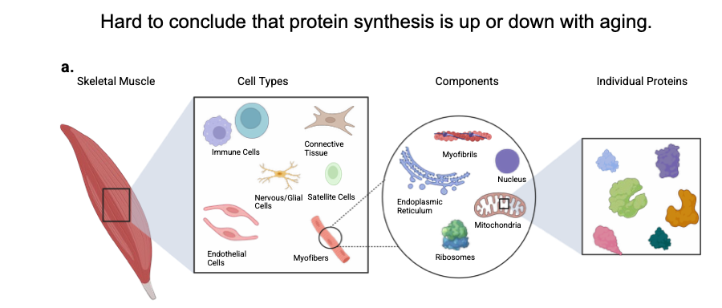
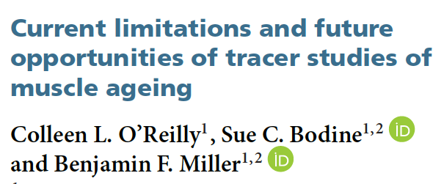
Protein turnover is heterogenous

Slide 28
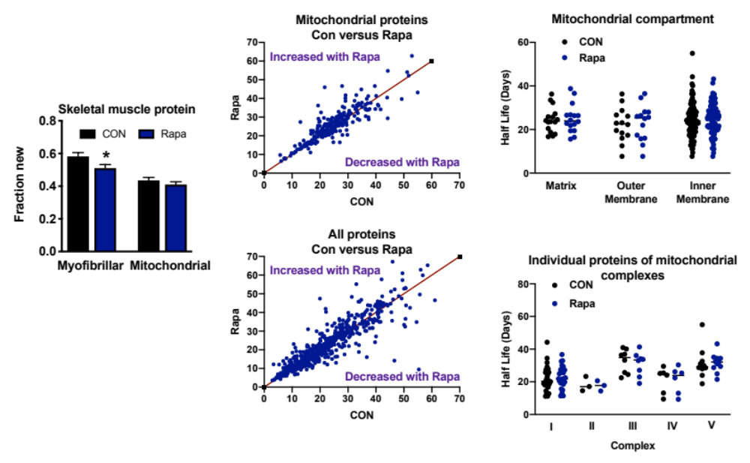
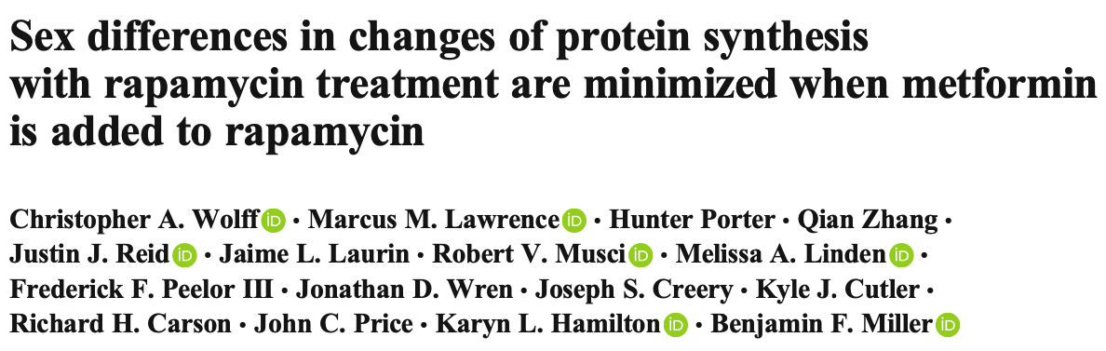
Protein turnover is heterogenous

Slide 29
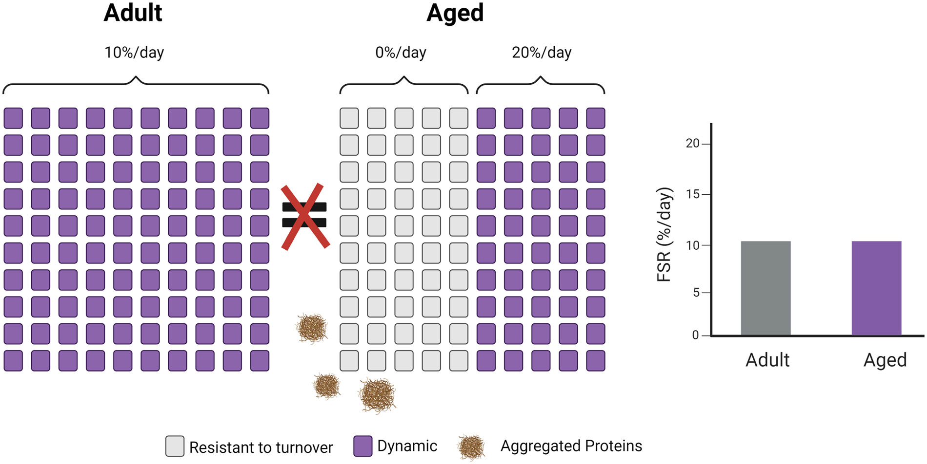
Not all proteins fully renew

Slide 30
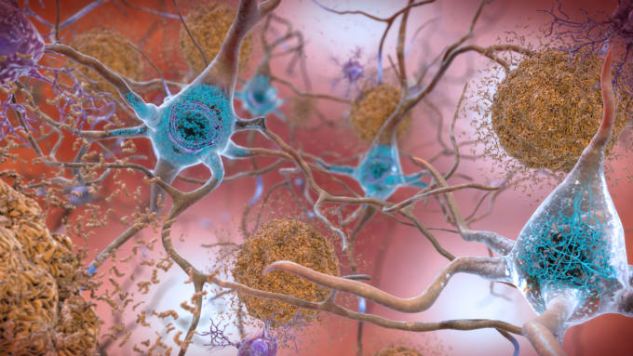
Not all proteins fully renew

Slide 31
To say that ”protein turnover” increases or decreases with age or gerotherpeutic interventions is overly simplistic.

Slide 32
Understand how to target protein turnover to slow aging.
Objective 4

Slide 33
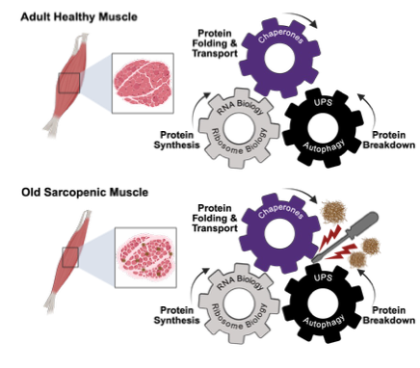
Turnover and proteostasis

Slide 34
Learning Objectives (revisted)
To understand the concept of metabolic flux.
To understand the limitations of snapshots compared to moving pictures.
Describe one approach for measuring flux.
To understand important factors in the flux (turnover) of protein.
Understand how to target protein turnover to slow aging.

Slide 35
GEROSCIENCE EDUCATION & TRAINING
Energy and Metabolism:
Metabolic Flux and Protein Metabolism
Brought to you by

