Slide 1




GEROSCIENCE EDUCATION & TRAINING
Energy and Metabolism: Preclinical Models and Methods for Studying Metabolic Flux
Brought to you by

Slide 2
GEROSCIENCE EDUCATION & TRAINING
The Geroscience Education and Training Network and the GET 2 Network Collaborative (GET Network + GSA) are supported by the National Institute on Aging of the National Institutes of Health under Awards Number R25AG073119 (NIA GCG) and R25AG091038 (NIA DAB).
The content is solely the responsibility of the authors and does not necessarily represent the official views of the National Institutes of Health.
Brought to you by

Slide 3
Preclinical models and methods for studying metabolic flux
The limits of snapshots when trying to understand a moving picture.

Slide 4
Learning Objectives
Understand how mice and rats differ regarding aging and metabolism
Understand how strain impacts outcomes of aging and metabolism
Understanding of how sex interacts with species and strain

Slide 5
Krogh Principle
"for ... a large number of problems there will be some animal of choice, or a few such animals, on which it can be most conveniently studied."

Slide 6
To understand how mice and rats differ regarding aging and metabolism
Objective 1

Slide 7
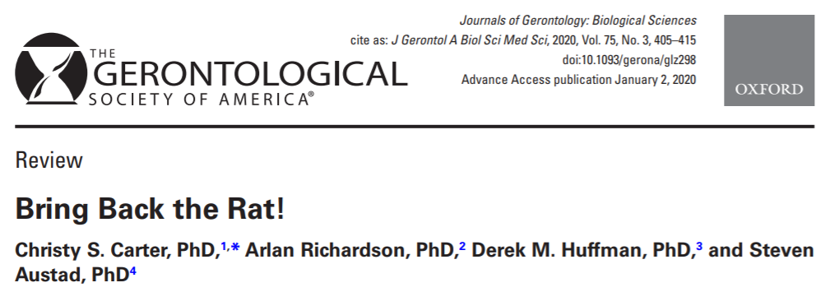
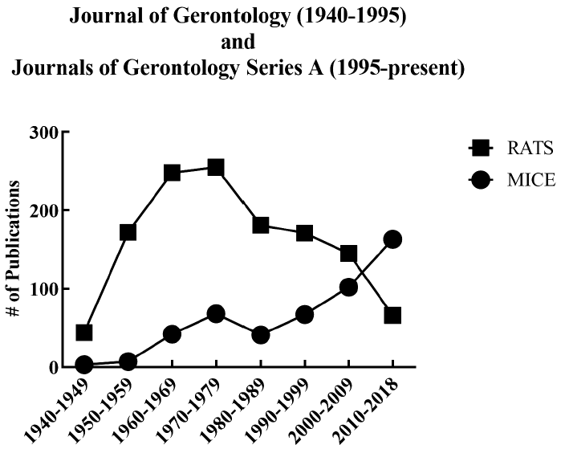
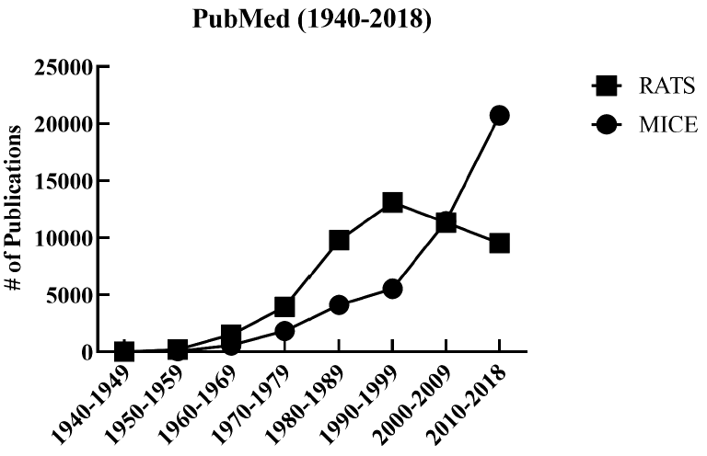
Rodent models in aging
Rats
Quantity of tissue
Easier to handle
Mice
Genetic tractability
Ease of housing
Cost
Availability of tools

Slide 8
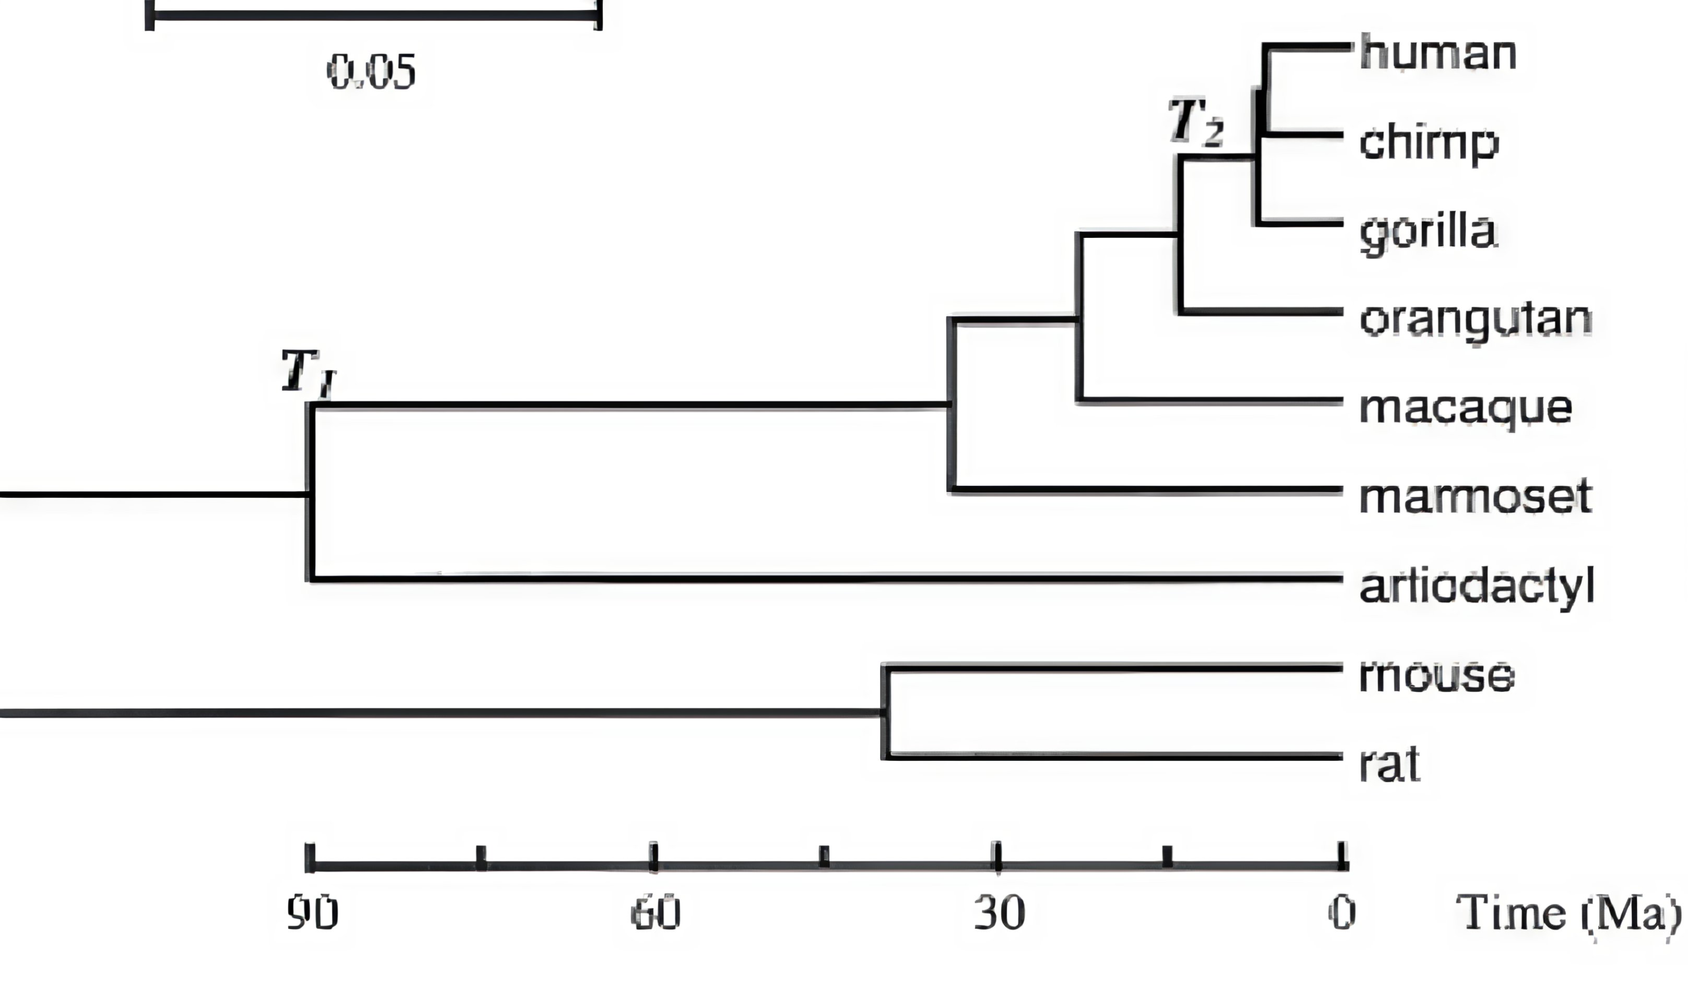
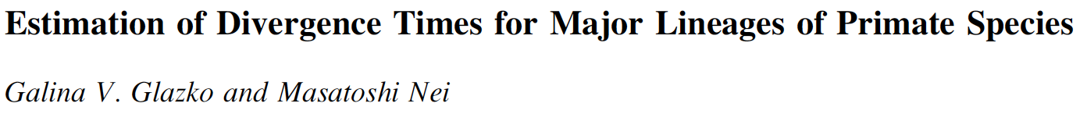
Evolutionary Relationship Between Rats and Mice
Humans and rhesus diverged ~25 million years ago
Rats and mice diverged ~30 million years ago
Millions of Years

Slide 9
Maximum Lifespan of Common Laboratory Rats and Mice
Male
Female

Slide 10
Rodent versus human pathology
Incidence of Major Pathology
Cancer
Heart Disease
Renal Disease

Slide 11
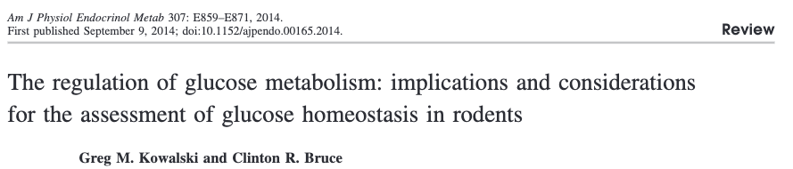
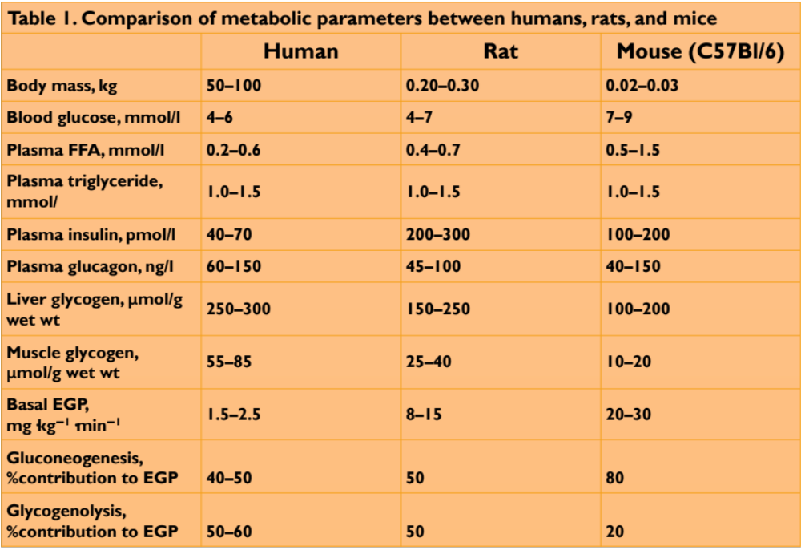

Slide 12
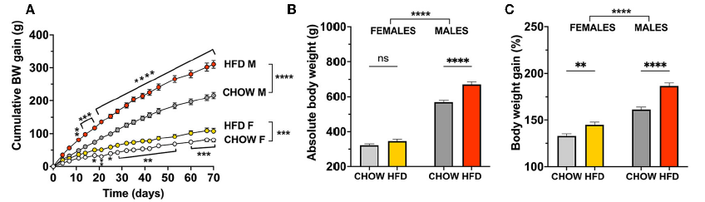
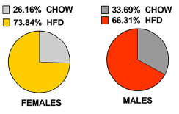
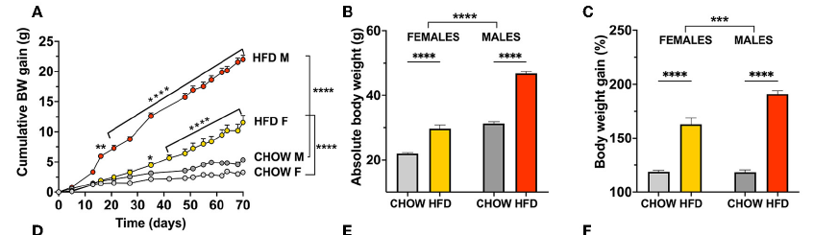
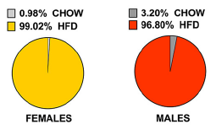
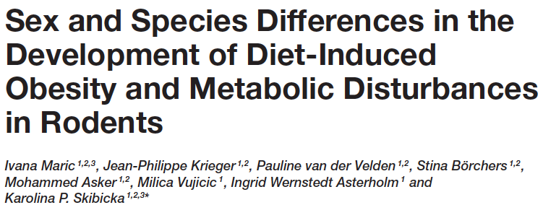
Rodent versus human metabolism
Rats
Food preference
Mice

Slide 13
Muscle Differences
 | Change in force (%) | Change in mass (%) | Change in myofiber # (%) | Change in myofiber CSA | Change in specific tension (%) | Change in moto-neuron (%)
Men | 40 | 35 | 25 | I 5% II 35% | 20 | 10-25
Male C57Bl6 | 20 | 15 | 20 |  | 10
Male F344BN | 45 | 25 | 20 | I 10% IIA 10% IIB 30% | 30 | 20
Male F344 | 20 | 15 | 10 | I 0-10% IIA 0-15% IIB 10-25% | 10 | 10
Male Wistar | 10 | 10 | 5 | I 5-10% IIA 15-20% | 0

Slide 14
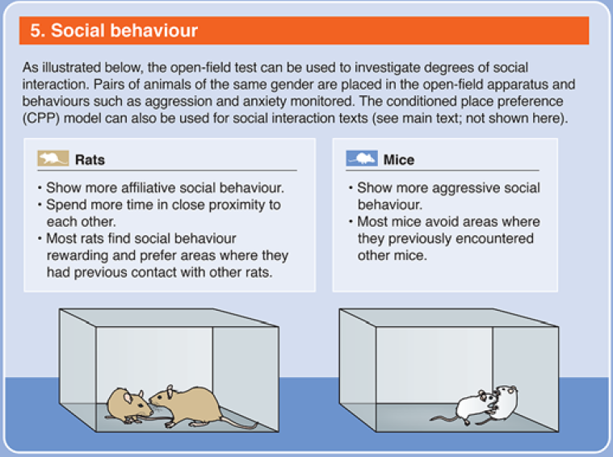
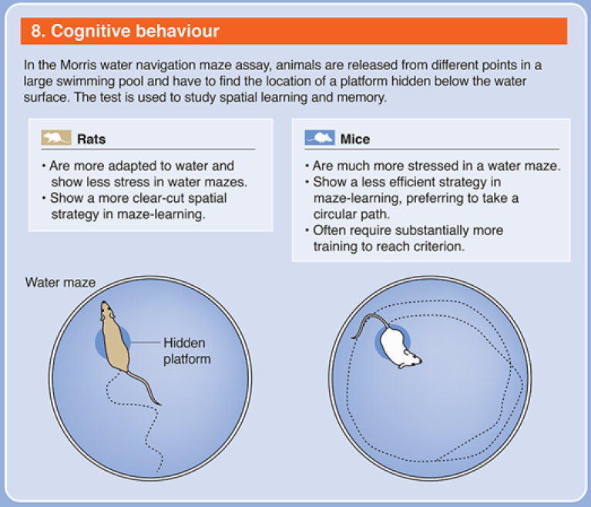
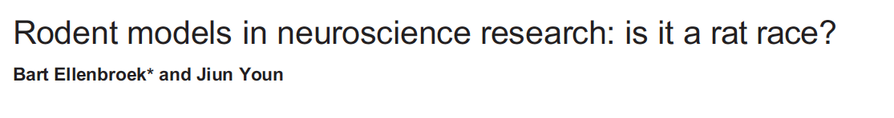
Brain Differences

Slide 15
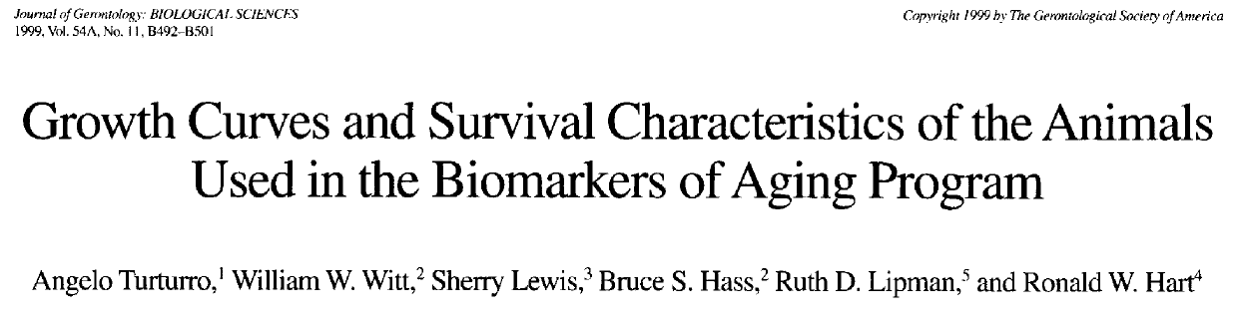
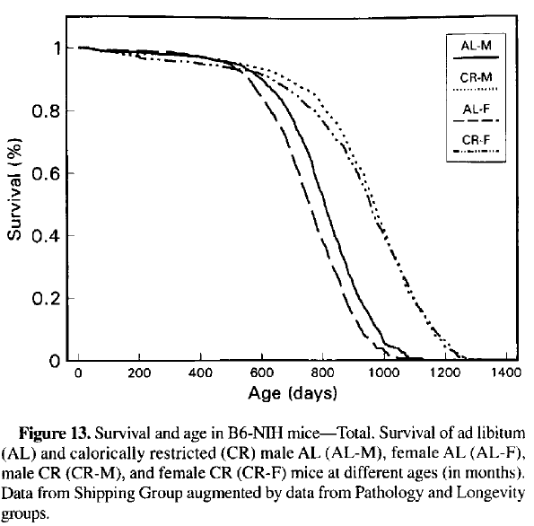
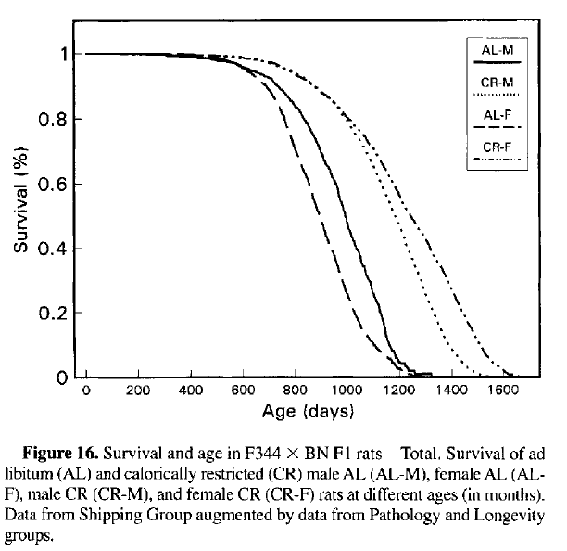
Lifespan extension differences
26-27 months
36 months
30%
40%
35 months
40 months

Slide 16
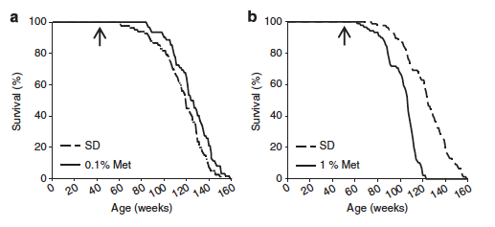
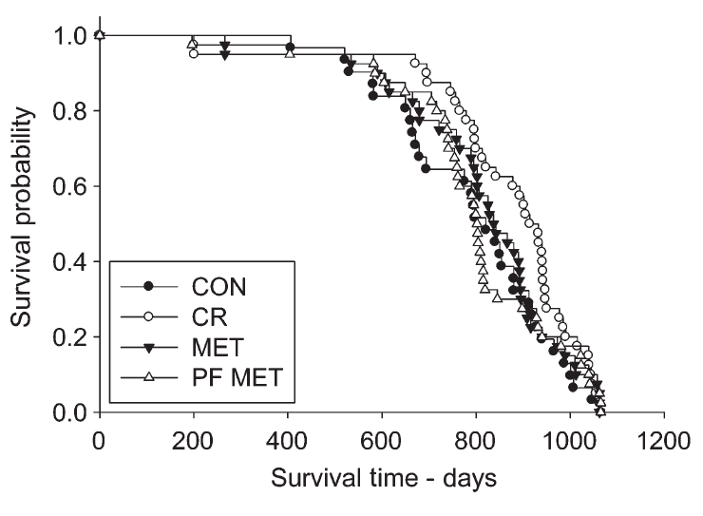
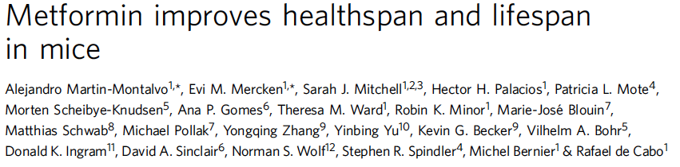
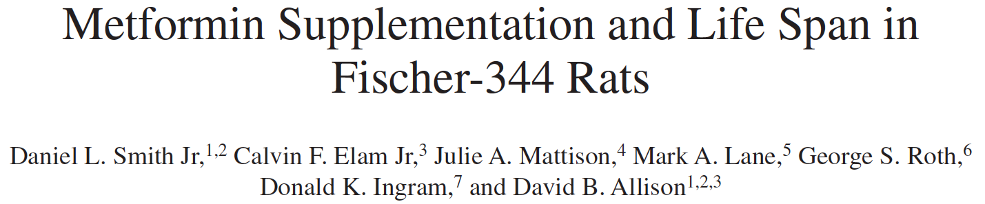
Lifespan extension differences

Slide 17
To understand how strain impacts outcomes of aging and metabolism
Objective 2

Slide 18
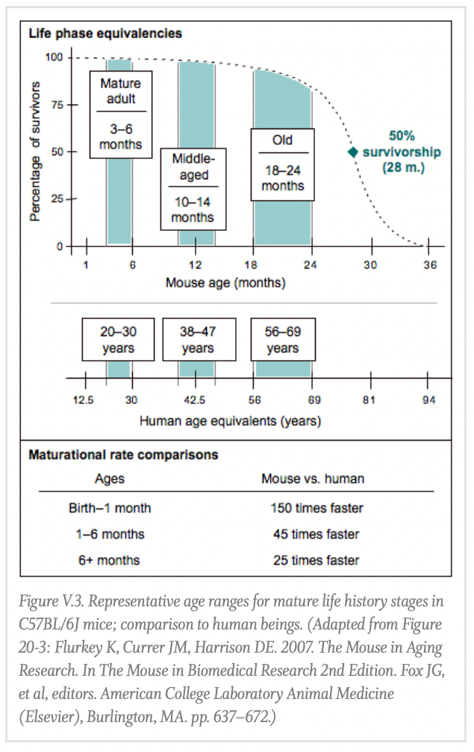
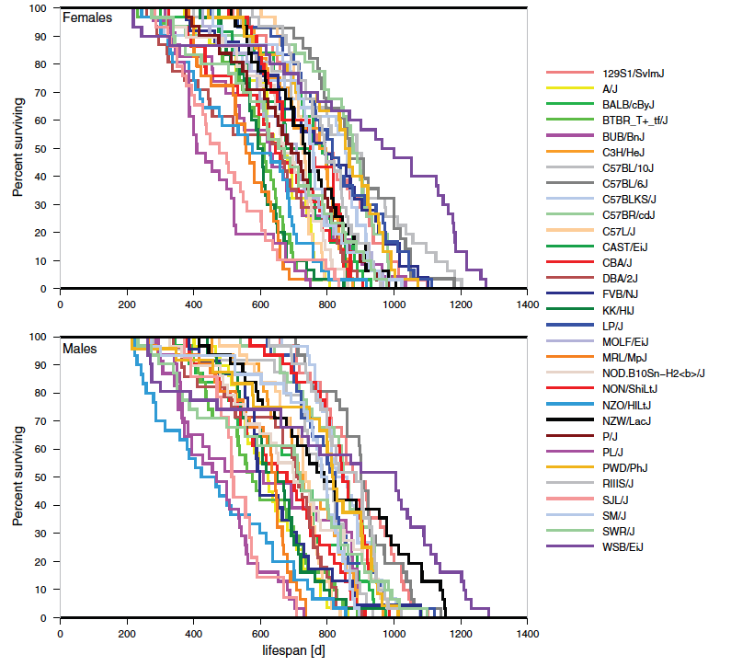
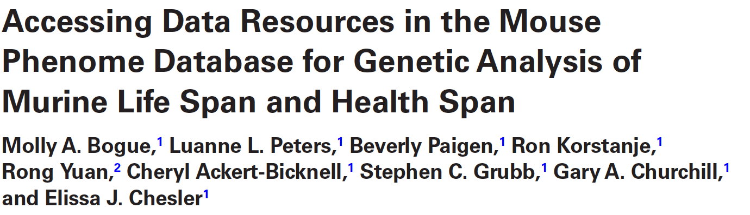
Strain Considerations

Slide 19
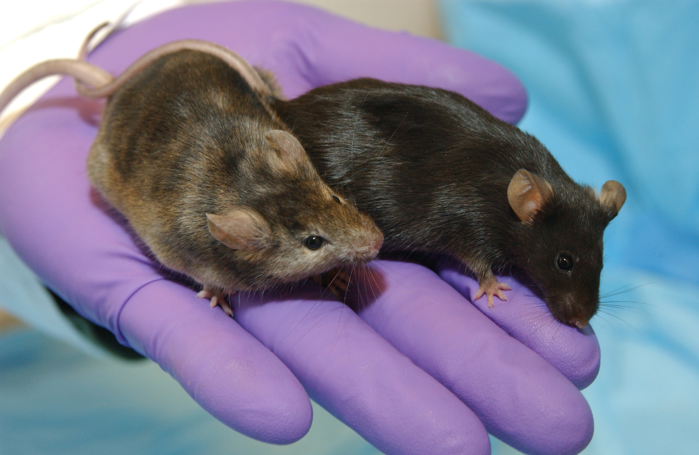
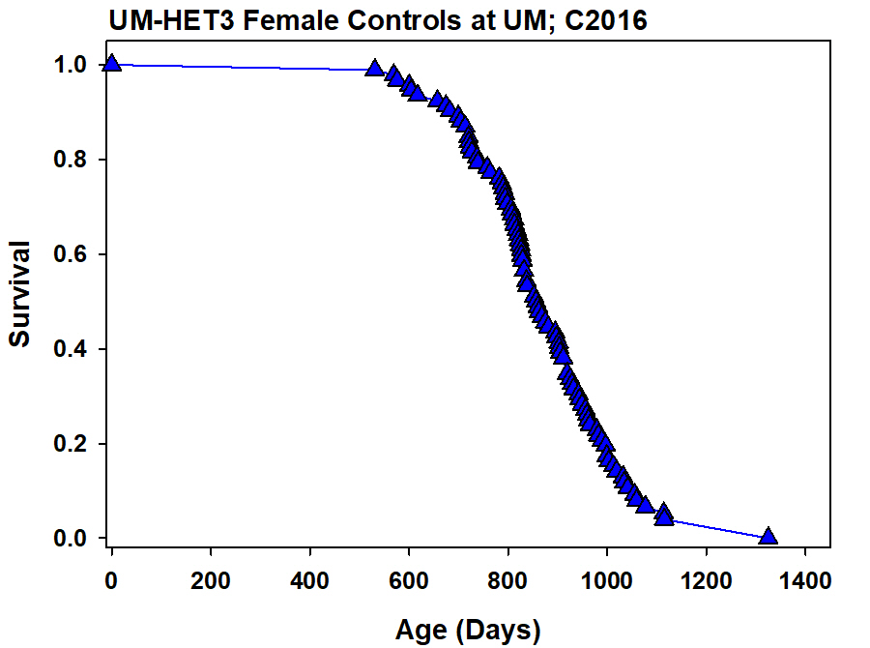
Strain Considerations
C57BL/6 Median Lifespan ~32 months from
OUHSC,
Richardson
Median Lifespan
~28 months
UM-HET3 Mice (F2): CB6F₁ females (BALB/cJ and C57BL/6J) crossed to C3D2F₁ males (C3H/HeJ X DBA/2J)
UM-HET3 lifespan data from Rich Miller

Slide 20
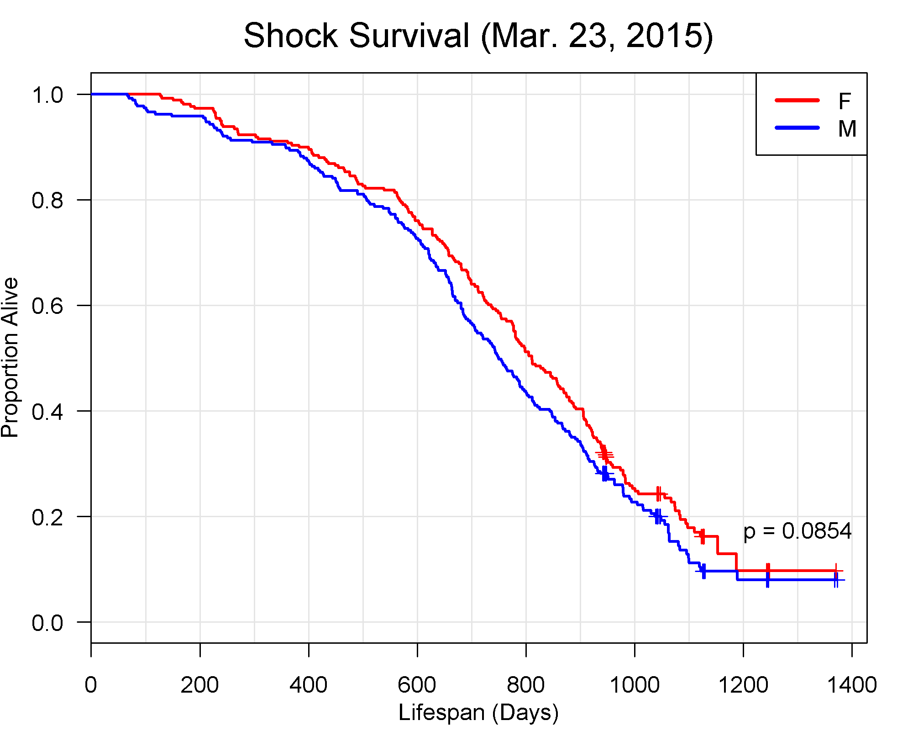
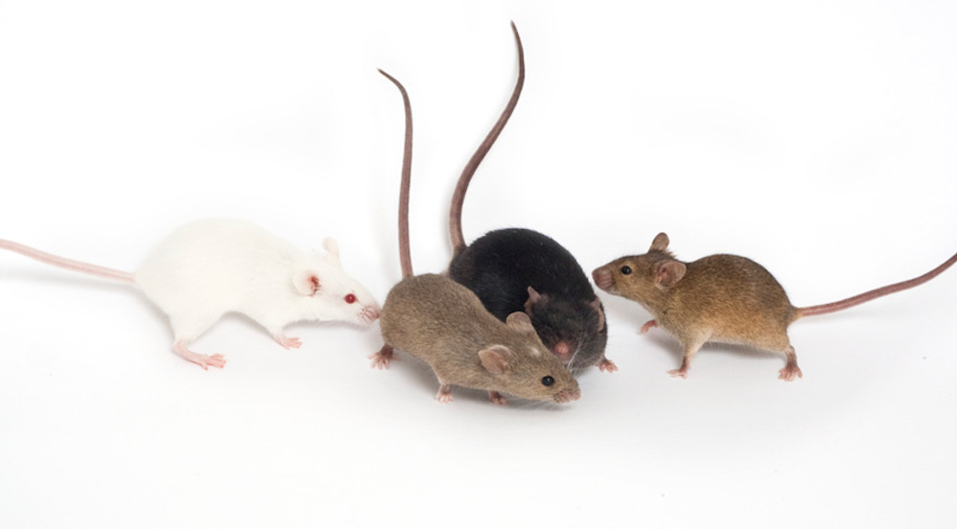
Strain Considerations
C57BL/6 Median Lifespan ~32 months from
OUHSC,
Richardson
Median Lifespan
~24 months
Diversity Outcross (DO): Derived from 8-way cross using 5 inbred strains (A/J, C57BL/6J, 129S1/ SvImJ, NOD/LtJ, and NZO/HlLtJ) and 3 wild-derived strains (CAST/ EiJ, PWK/PhJ, and WSB/EiJ)
Lifespan for DO mice from Gary Churchill at JAX

Slide 21
To understanding of how sex interacts with species and strain
Objective 3

Slide 22
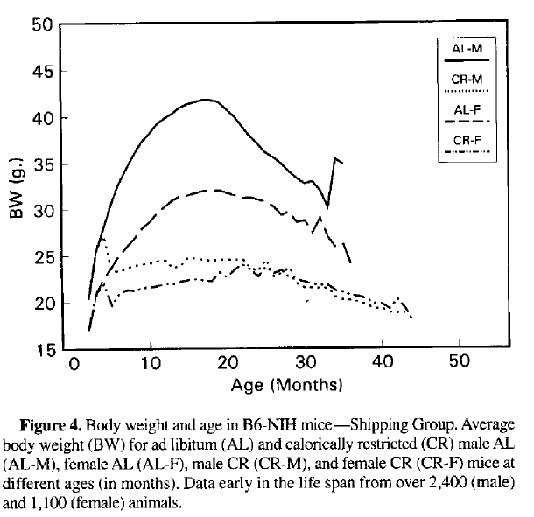
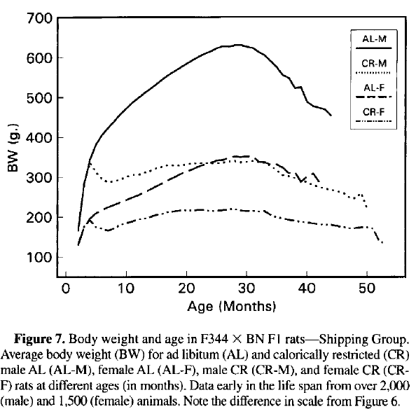
Sex Differences
1.3x
1.9x

Slide 23
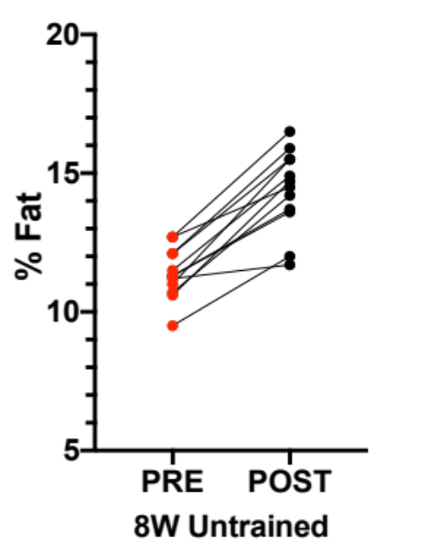
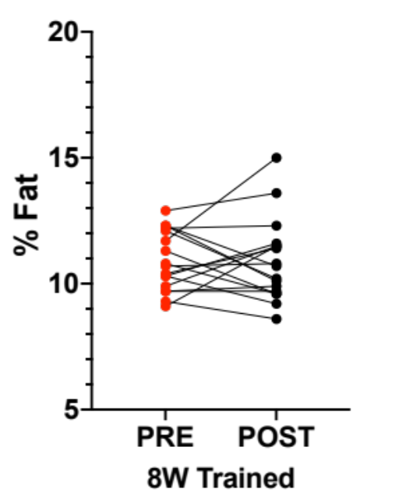
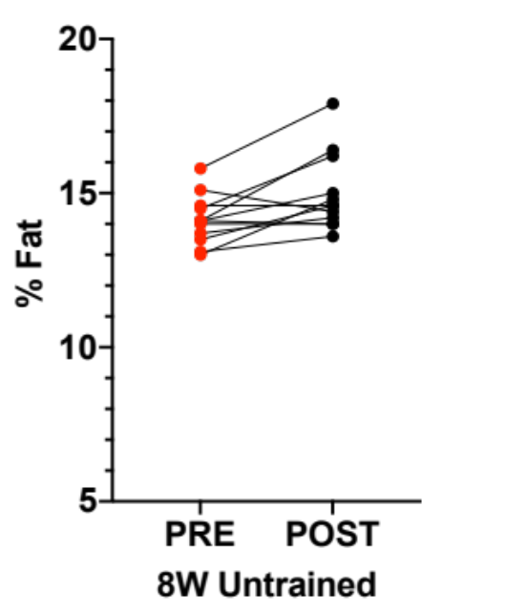
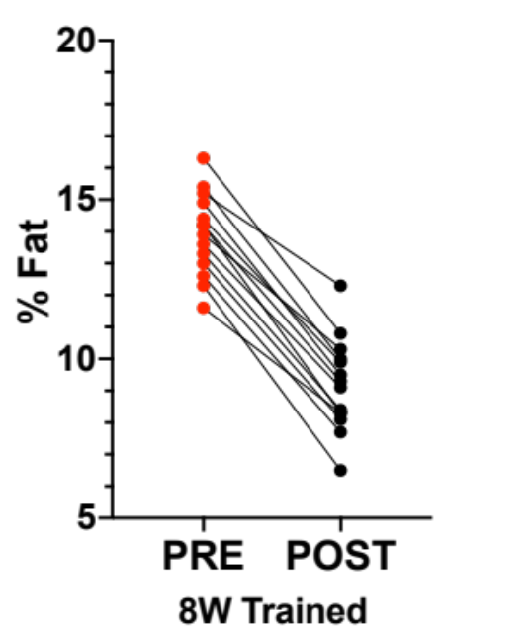
Sex Differences
Female
Male
MoTrPAC
8 weeks aerobic exercise training at 6 months of age

Slide 24
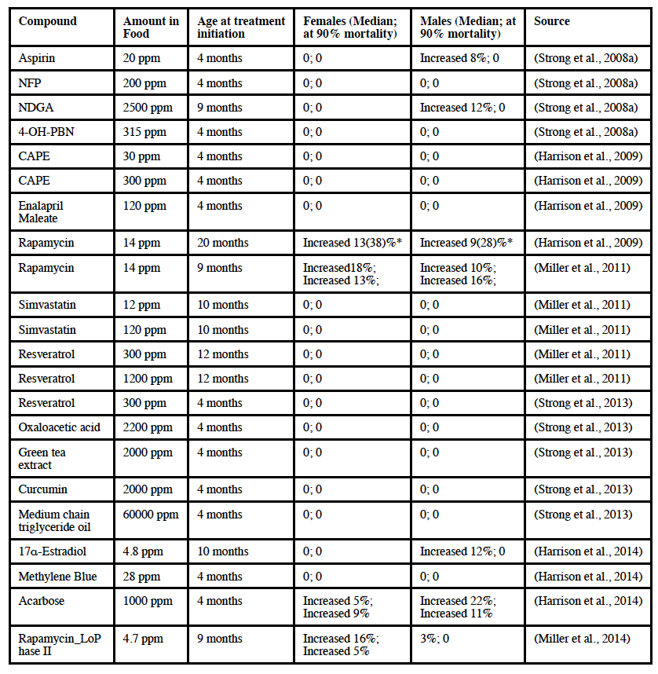
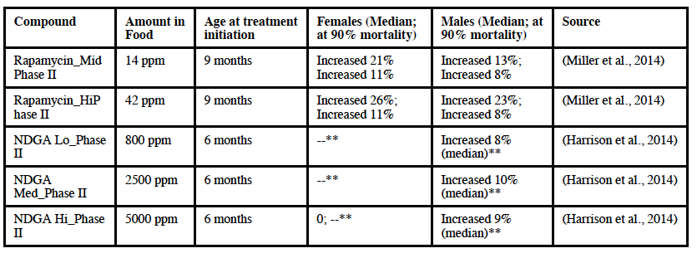
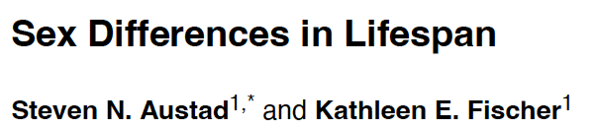
Sex Differences
Acarbose+Rapa
Metformin+Rapa

Slide 25
Other important reminders
Objective 4

Slide 26
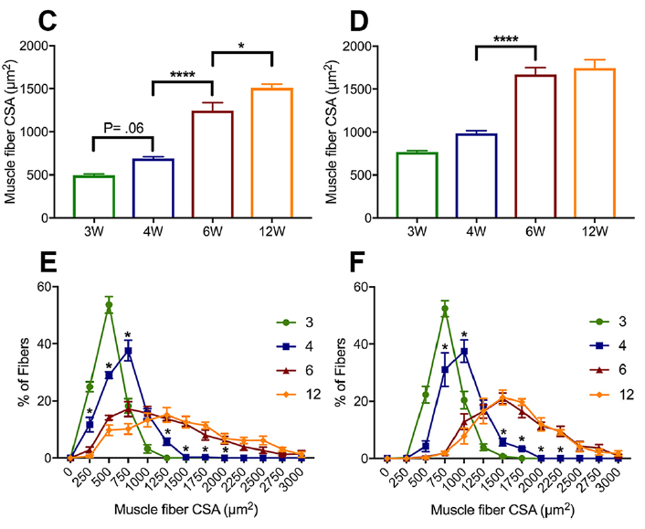
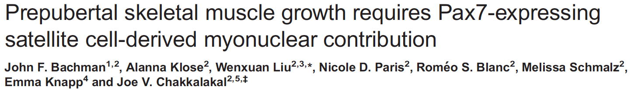
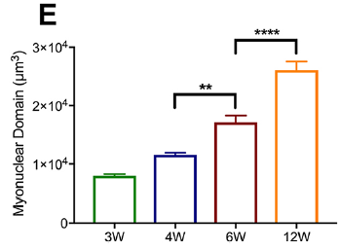
Age (the control)

Slide 27
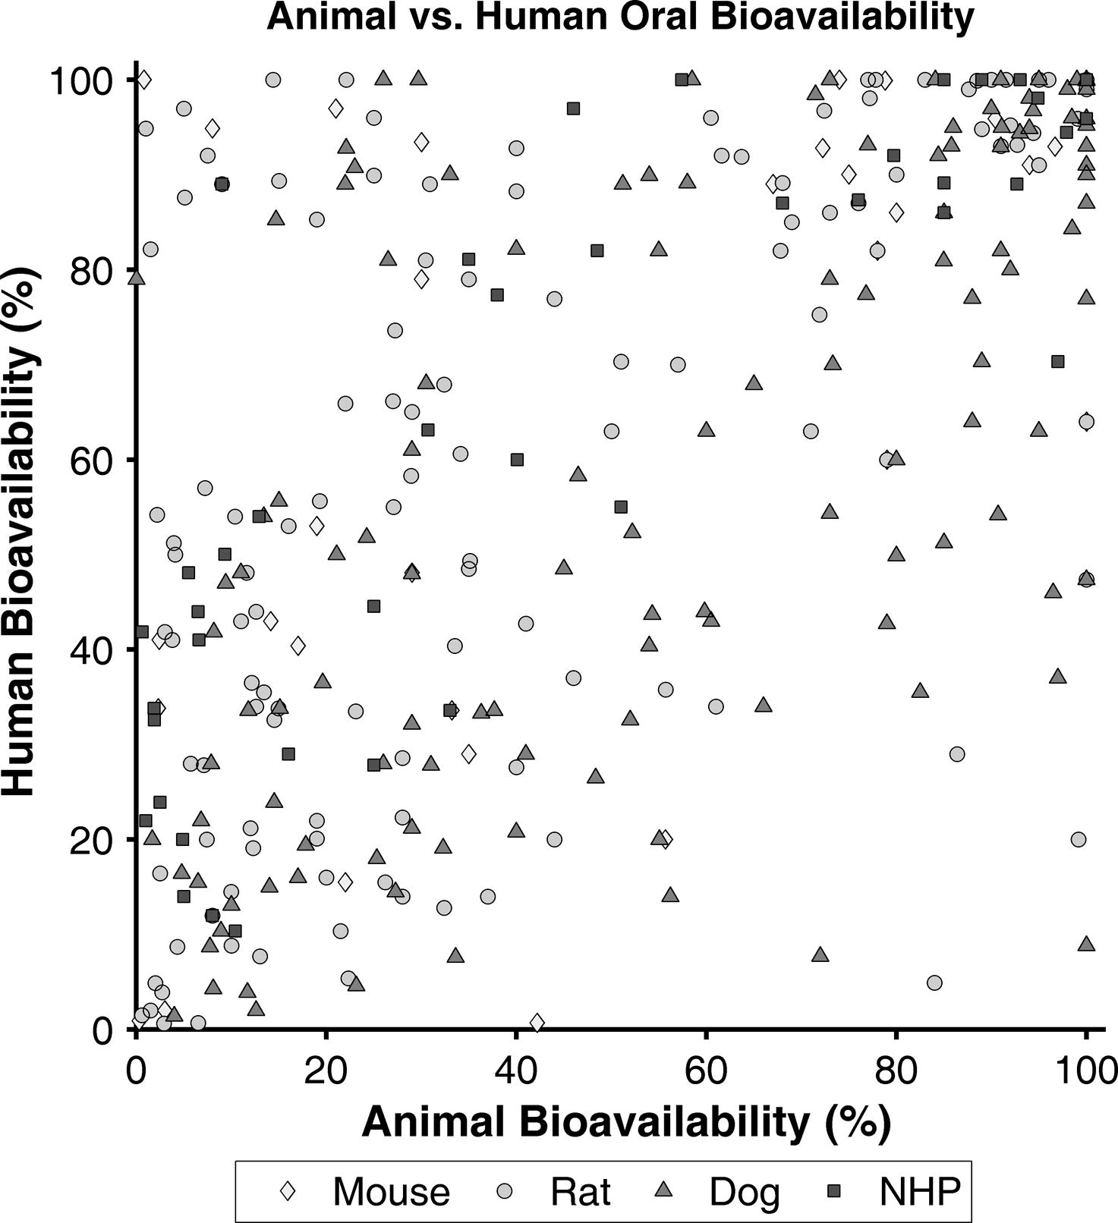
Bioavailability

Slide 28
What is your goal?
Mechanism
  Genetic tractability – Mice
Translation
  Some organ systems and the trajectory of aging – Rats
Adopt model based on experimental goals

Slide 29
Learning Objectives (revisted)
Described how mice and rats differ regarding aging and metabolism
Described how strain impacts outcomes of aging and metabolism
Described of how sex interacts with species and strain

Slide 30
GEROSCIENCE EDUCATION & TRAINING
Energy and Metabolism: Preclinical Models and Methods for Studying Metabolic Flux
Brought to you by

