Slide 1




GEROSCIENCE EDUCATION & TRAINING
Energy and Metabolism: Core Energy Metabolism and Signaling
Brought to you by

Slide 2
GEROSCIENCE EDUCATION & TRAINING
The Geroscience Education and Training Network and the GET 2 Network Collaborative (GET Network + GSA) are supported by the National Institute on Aging of the National Institutes of Health under Awards Number R25AG073119 (NIA GCG) and R25AG091038 (NIA DAB).
The content is solely the responsibility of the authors and does not necessarily represent the official views of the National Institutes of Health.
Brought to you by

Slide 3
Core energy metabolism and signaling
How carbohydrates and lipids are mobilized and used at the systemic and cellular levels

Slide 4
Learning Objectives
Understand storage and mobilization of glucose and fat (lipids)
Learn cellular pathways to take up and harvest energy from these molecules
Become familiar with two key intracellular
energy sensors, mTORC1 and AMPK

Slide 5
Understand storage and mobilization of glucose and fat (lipids)
Objective 1

Slide 6
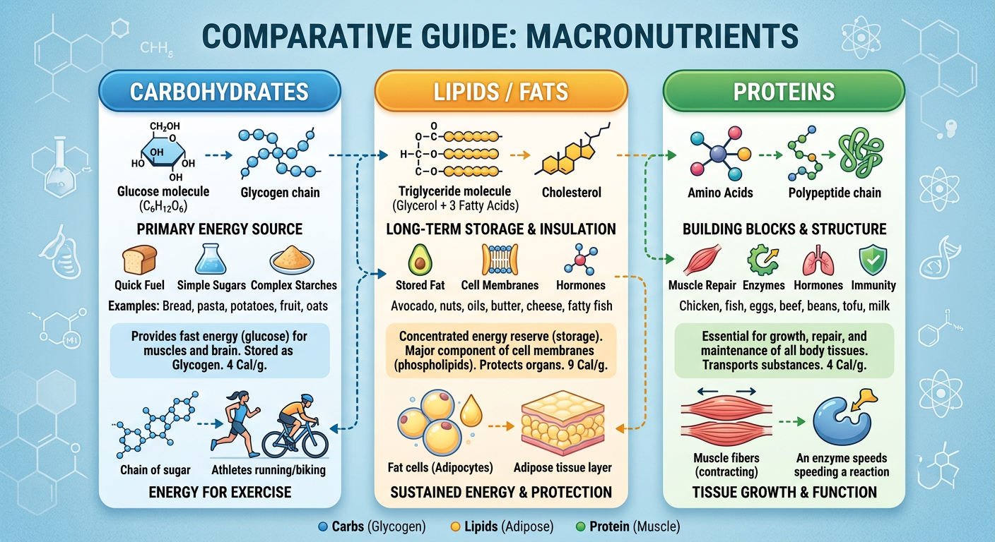
Macronutrients

Slide 7
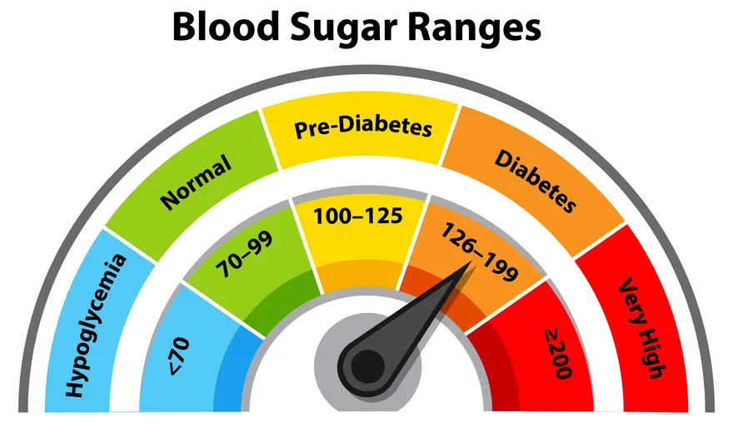
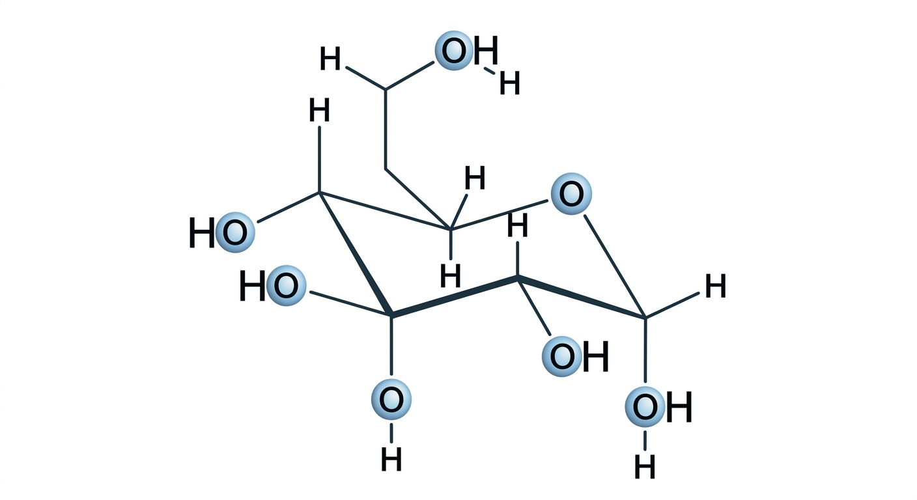
Glucose is the main sugar in blood
Fasting
(mg/dL)
Glucose
Image: www.metropolisindia.com

Slide 8
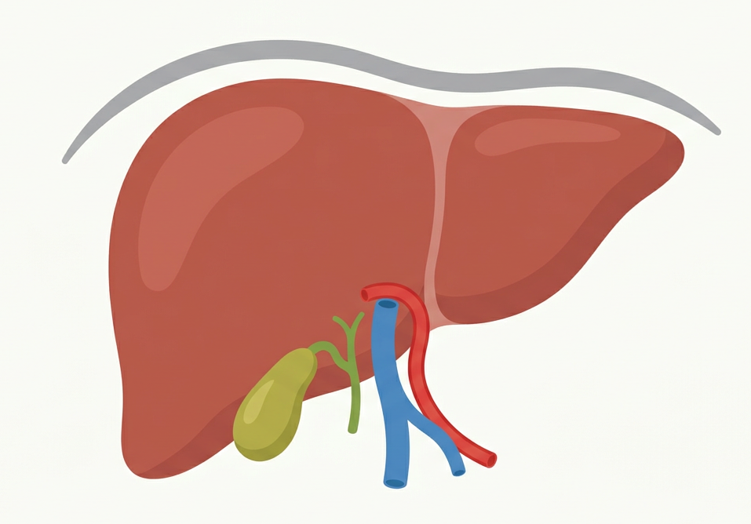
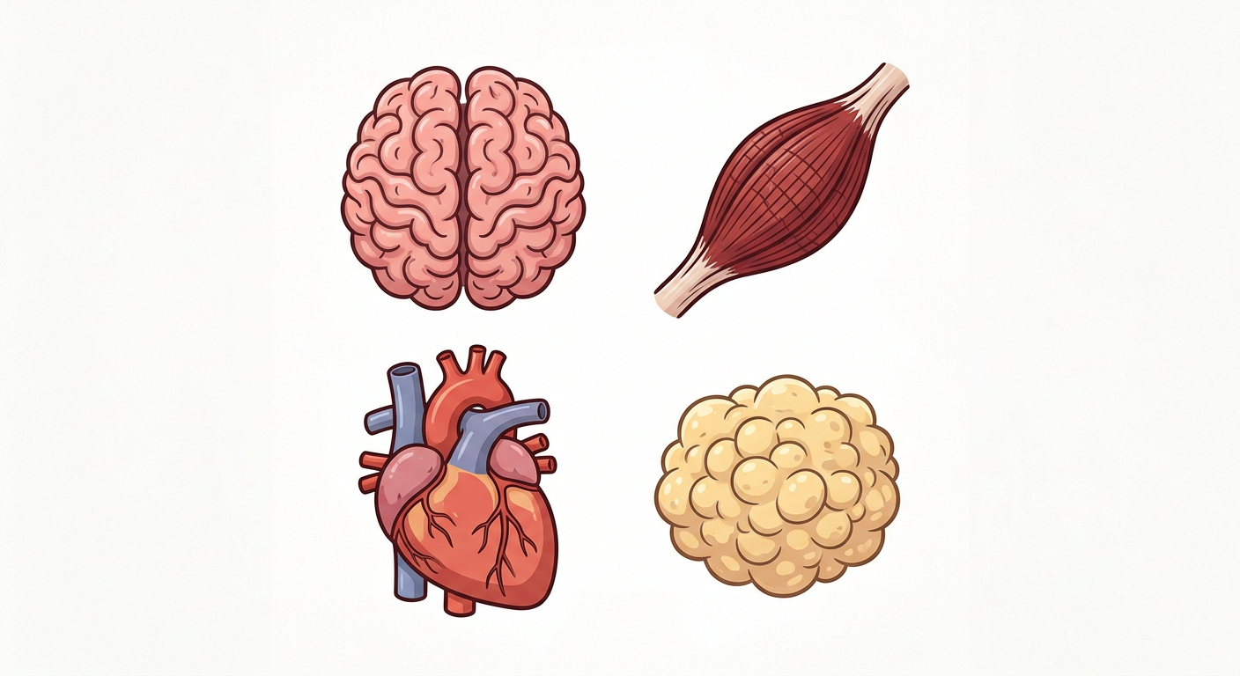

Glucose comes from food and the liver
Glucose

Slide 9
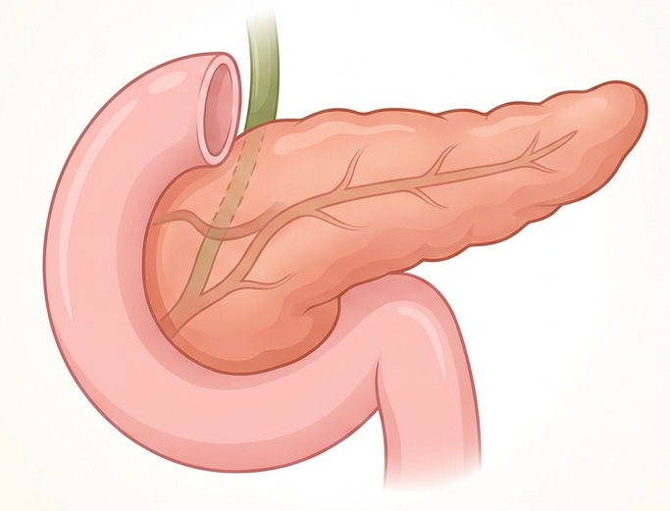
Insulin and glucagon from the pancreas regulate glucose
Insulin
Increases tissue uptake
Decreases liver production
High glucose
Glucagon
Increases liver production
Low glucose

Slide 10
Insulin maintains glucose levels
Insulin
Glucose

Slide 11
Insulin maintains glucose levels
Insulin
Glucose

Slide 12
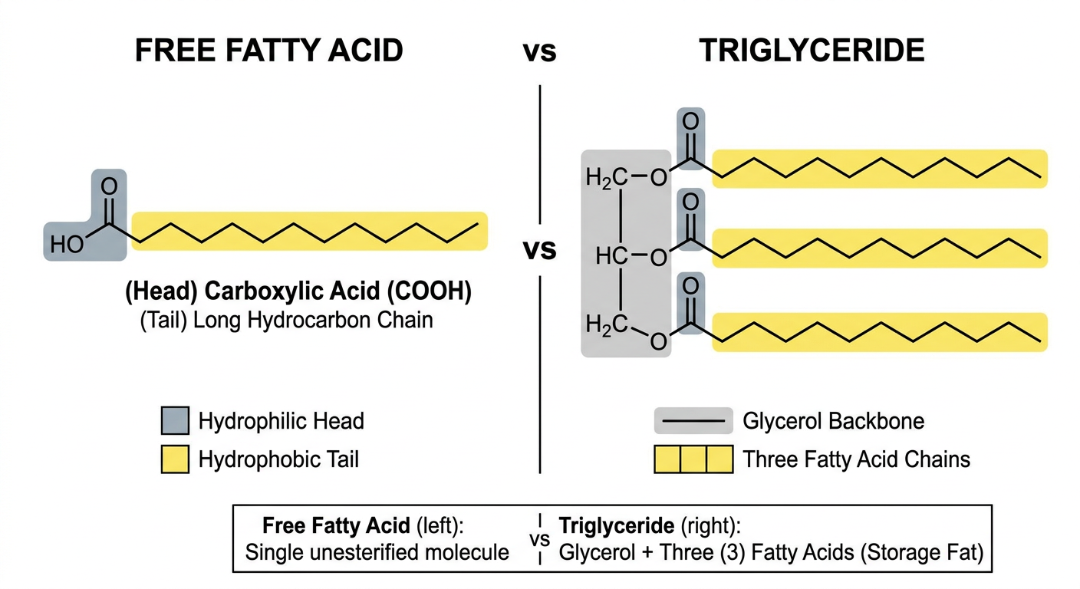
Main circulating lipids (fats)

Slide 13
Circulating Lipids in fasting and feeding
Fasting
Fed
Free Fatty Acids
Free Fatty Acids
Insulin
Triglycerides (VLDL)
Triglycerides (VLDL)
Triglycerides (Chylomicrons)

Slide 14
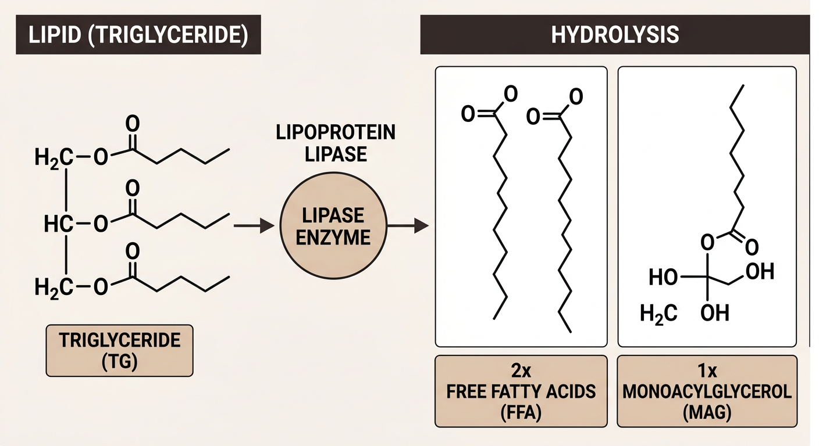
Triglycerides are hydrolyzed for uptake

Slide 15
Learn cellular pathways to take up and harvest energy from these molecules
Objective 2

Slide 16
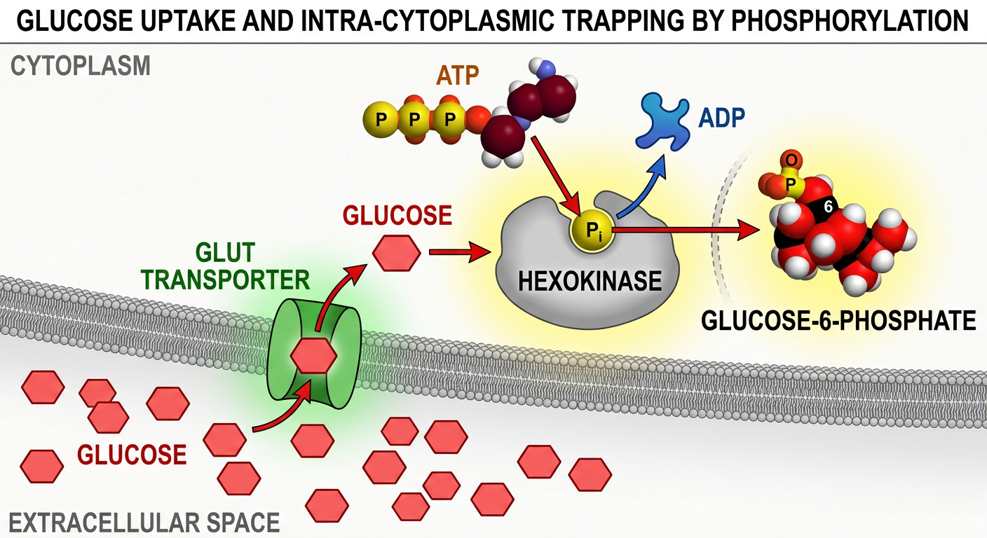
Glucose is trapped by phosphorylation

Slide 17
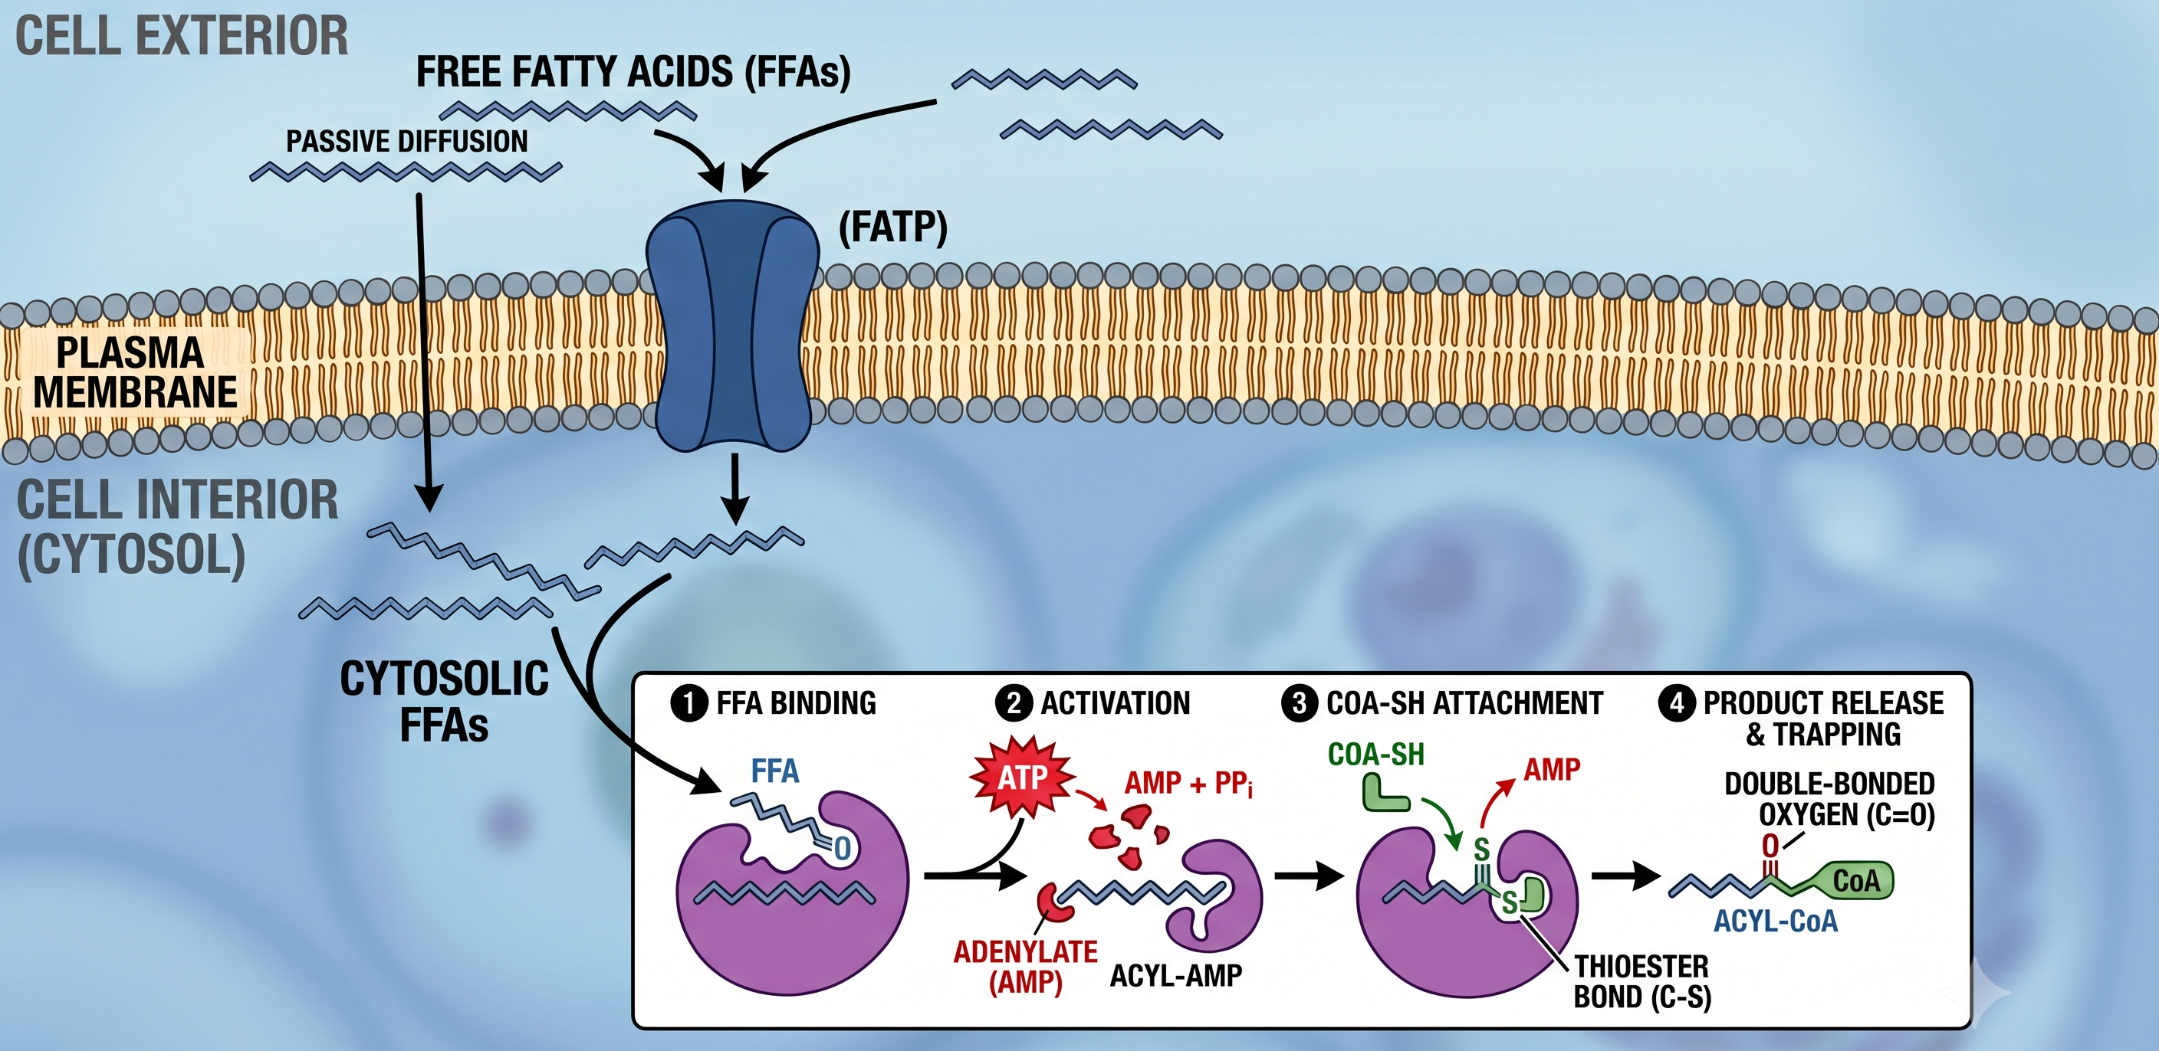
Fatty acids are trapped by CoA addition

Slide 18
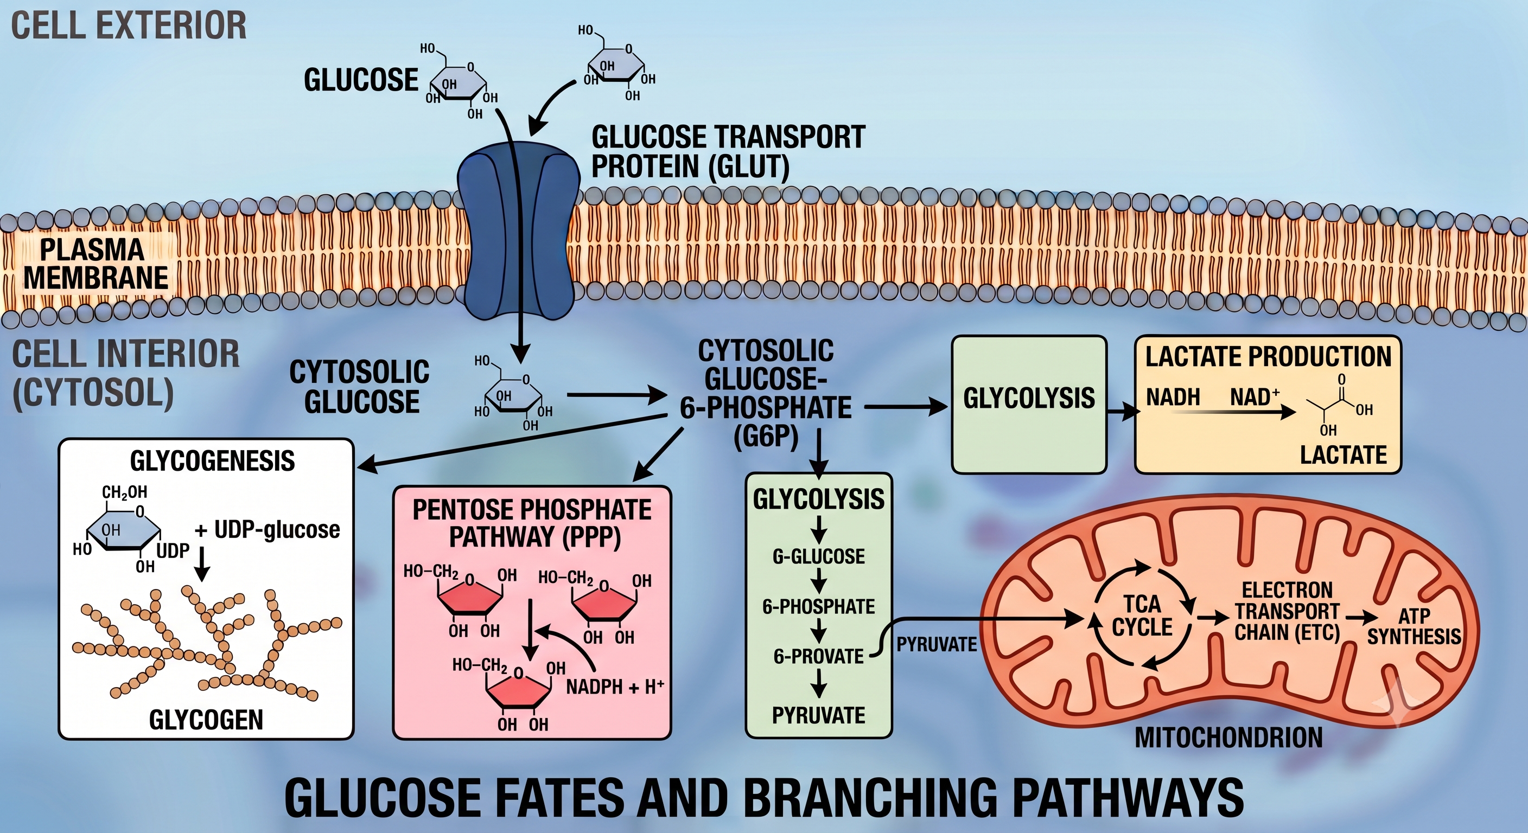
Glucose has many fates

Slide 19
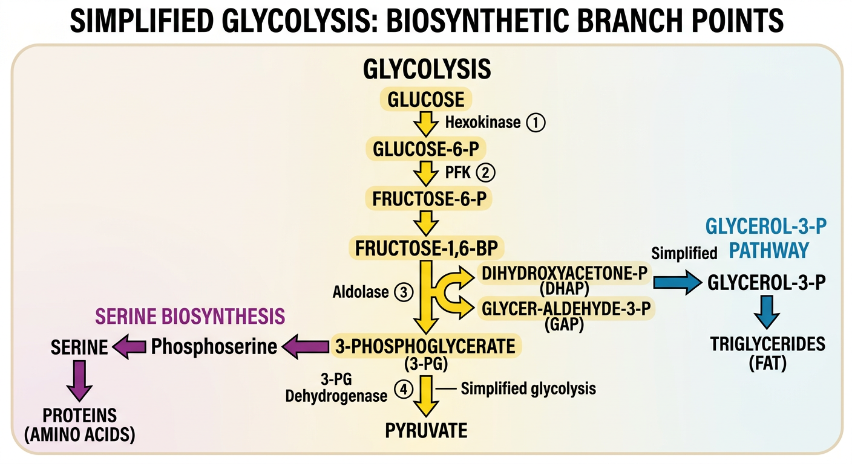
Metabolic pathways branch
2
+ 2 ATP + 2 NADH

Slide 20
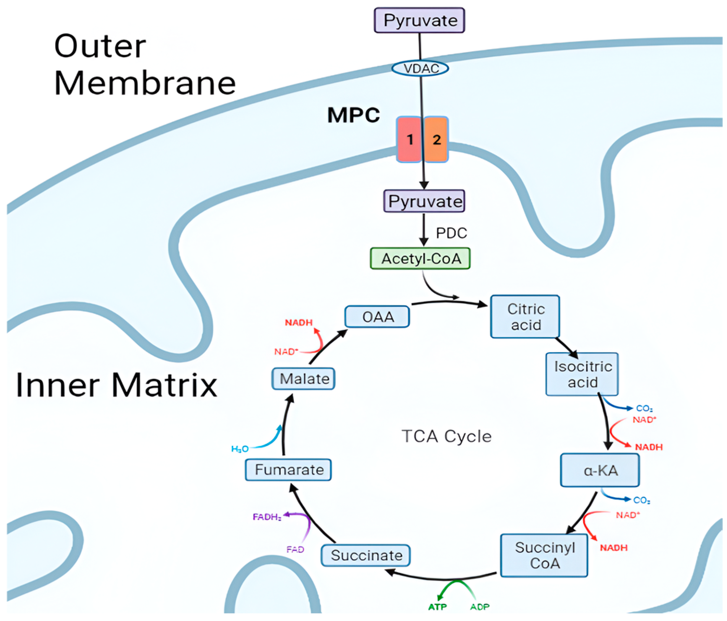
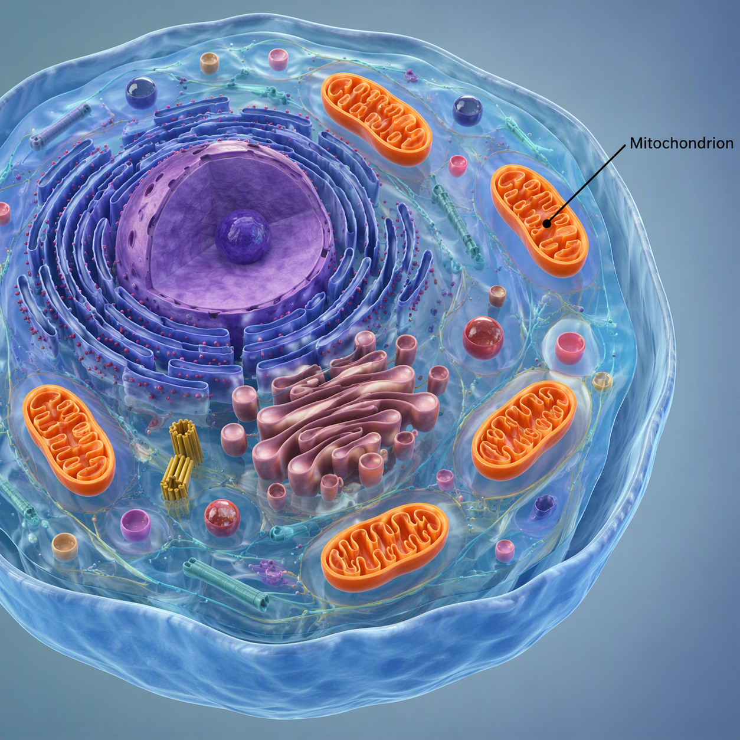
Mitochondria oxidize pyruvate
Politte et al, Biomolecules, 2025

Slide 21
Tricarboxylic acid cycle produces NADH/FADH₂
Each Acetyl-CoA:
3 NADH
1 FADH₂
1 ATP (or GTP)
AKG
Politte et al,
Biomolecules, 2025

Slide 22
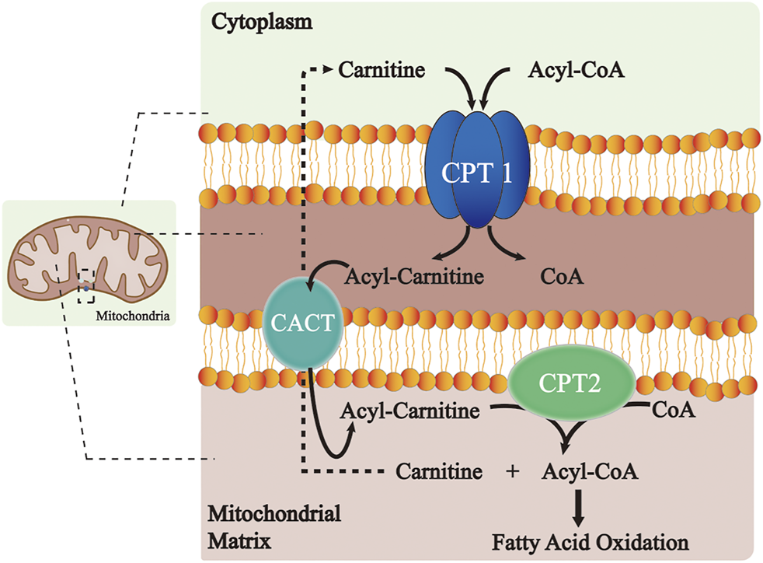
Mitochondria import fatty acids via Cpt1
Wang et al, Front Pharmacol, 2021

Slide 23
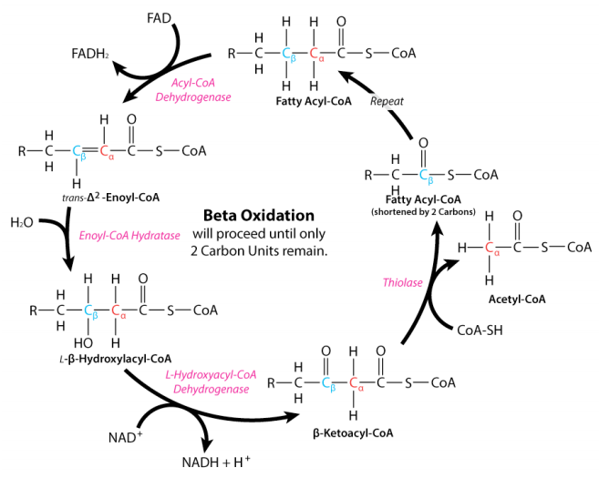
Mitochondria oxidize fatty acids to Acetyl-CoA
(Tricarboxylic acid cycle)
Each Acetyl-CoA:
3 NADH
1 FADH₂
1 ATP (or GTP)
Wang et al, Front Pharmacol, 2021

Slide 24
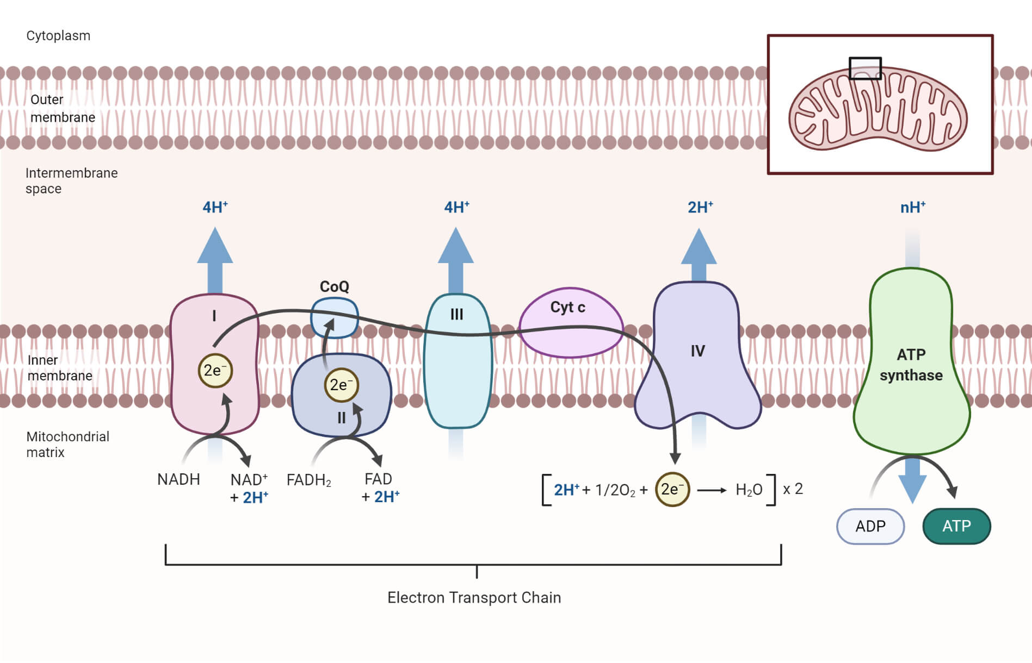
Electron transport chain (ETC) generates ATP
Anupama Sapkota/microbenotes.com

Slide 25
Intracellular sensing of nutrients and energy
Each Acetyl-CoA:
Starting from Glucose:
3 NADH
~2.5 ATP each = 7.5 ATP
Glycolysis
2 ATP
2 NADH (~5 ATP)
1 FADH₂
~1.5 ATP
Pyruvate dehydrogenase
2 NADH (~5 ATP)
1 ATP (or GTP)
1 ATP (or GTP)
10 ATP
2 Acetyl-CoA
20 ATP
~32 ATP/glucose

Slide 26
Become familiar with two key intracellular energy sensors, mTORC1 and AMPK
Objective 3

Slide 27
Intracellular sensing of nutrients and energy
Cells need to adapt to:
mTORC1 is a key indicator of nutrient sufficiency/growth
Availability of nutrients
Energetic demands
Presence or absence of key building blocks
Damage/stress
AMPK is a key indicator of energetic stress

Slide 28
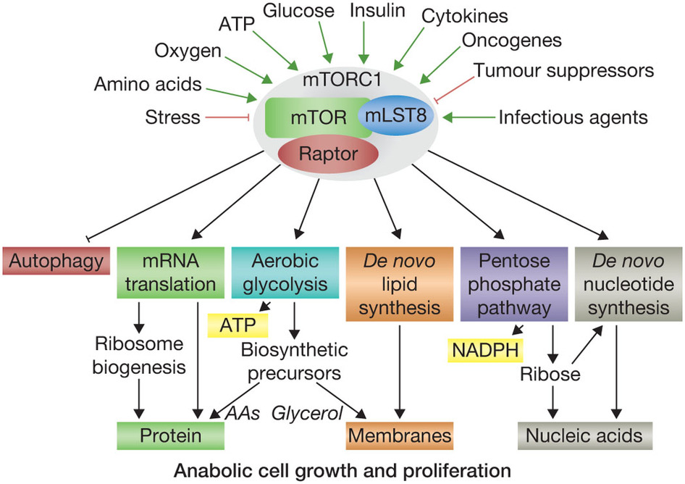
mTORC1 senses nutrients and promotes growth
Dibble and Manning,
Nature 15:555 (2013)

Slide 29
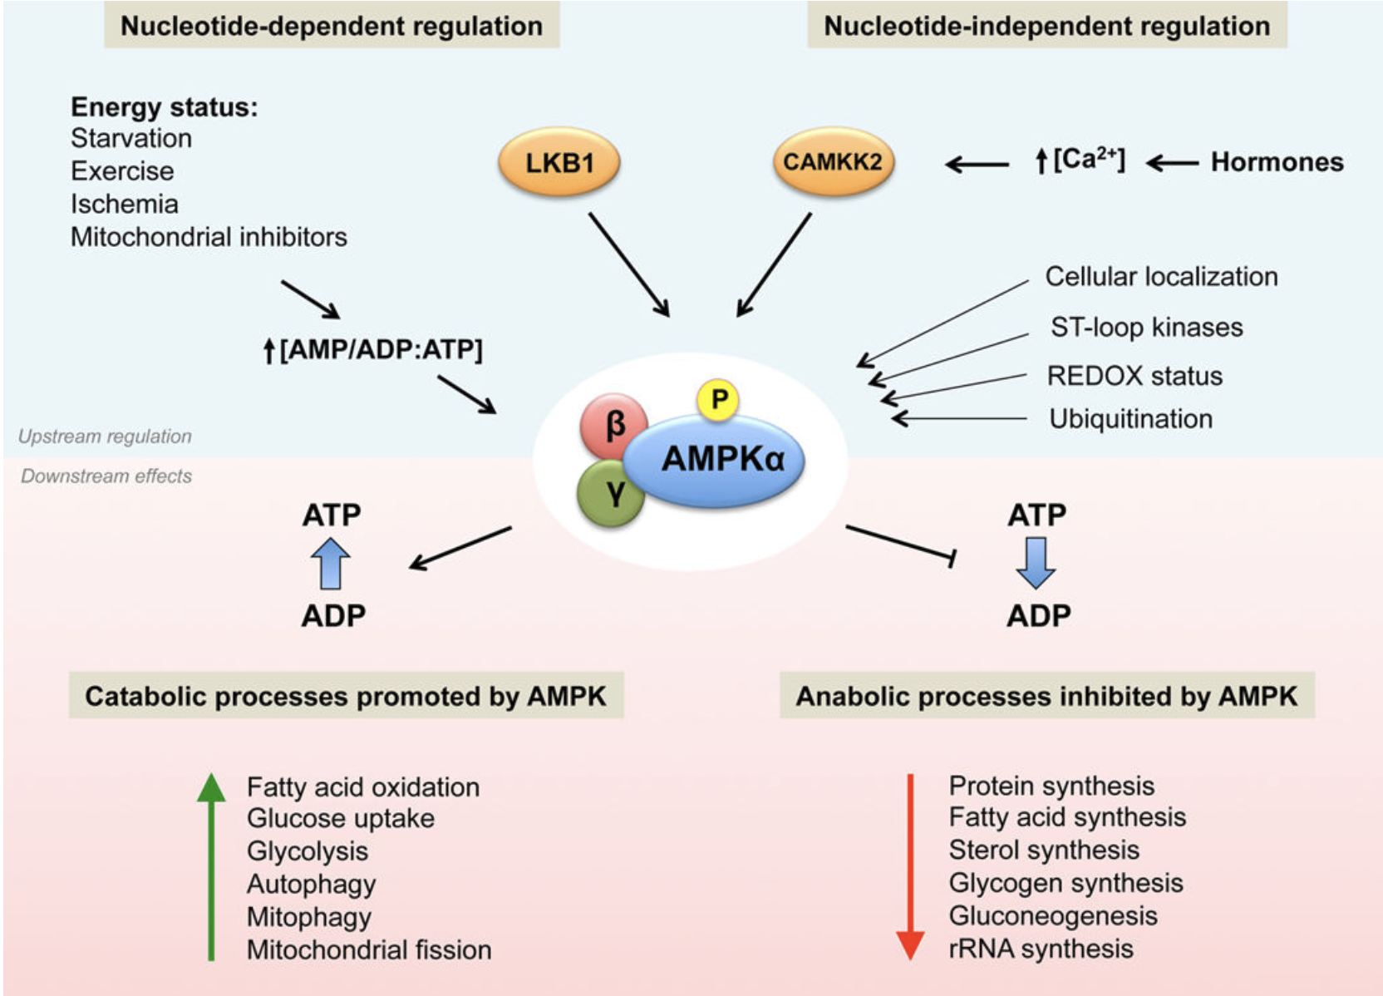
AMPK primarily senses energetic stress
Garcia and Shaw,
Mol Cell, 2017

Slide 30
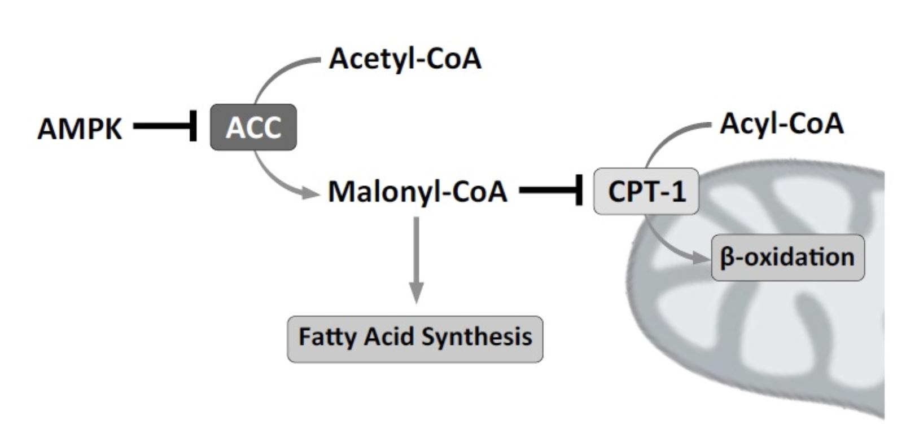
AMPK switches from fat synthesis to oxidation
Lipkova and Konhilas, Cardiovascular Pharmacology, 2015

Slide 31
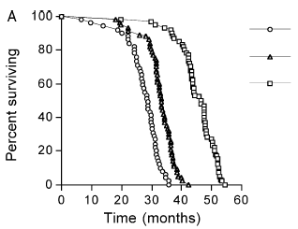
Can targeting mTORC1/AMPK mimic caloric restriction?
Control
mTORC1
Mild CR
Severe CR
Lifespan of mice
AMPK
Barger et al, Exp Gerontol, 2003

Slide 32
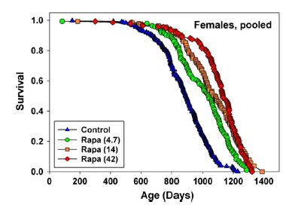
mTORC1 inhibitor rapamycin extends mouse lifespan
Miller et al, Aging Cell (2013)

Slide 33
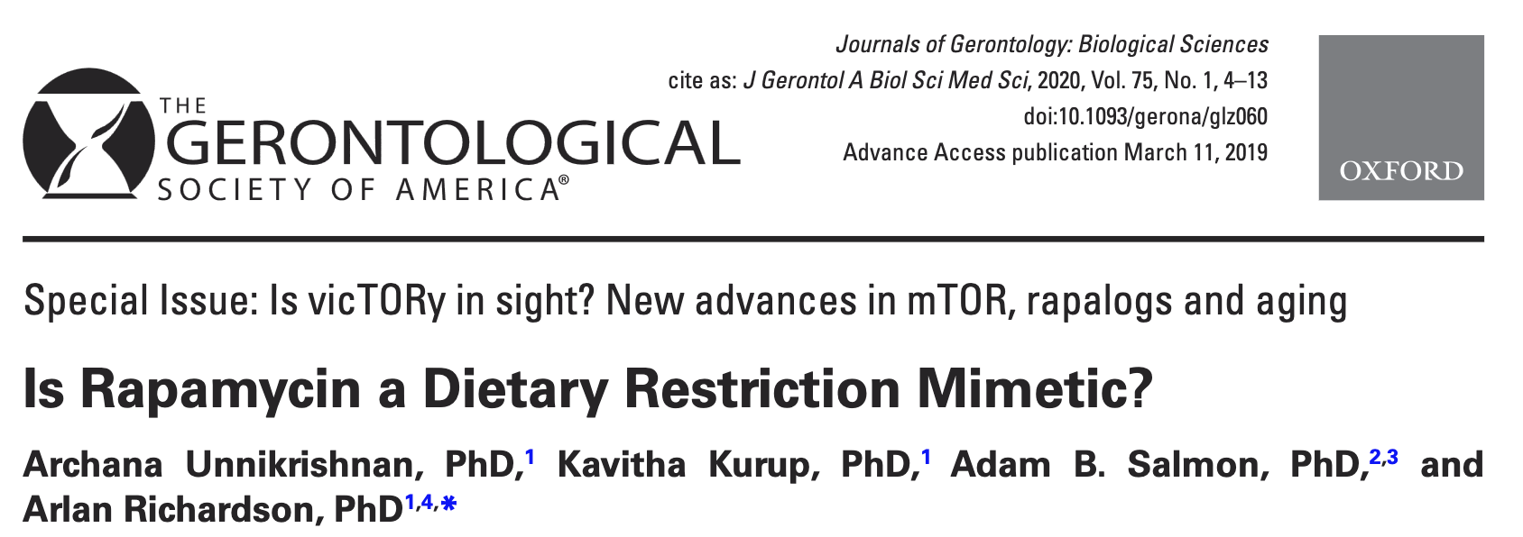
But may act differently from CR
“…while dietary restriction and rapamycin may have similar effects on some pathways and processes; overall, they affect many pathways/processes quite differently.”

Slide 34
Summary
Glucose and lipid metabolism
Blood glucose is dynamically maintained in a tight range as readily available fuel
Lipids contain more energy and are essential to meet sustained demand
Both are metabolized to fuel the TCA in mitochondria (and glucose generates additional ATP through glycolysis)
Cellular sensors can respond to nutrient and energy availability

Slide 35
GEROSCIENCE EDUCATION & TRAINING
Energy and Metabolism: Core Energy Metabolism and Signaling
Brought to you by

